Slide 1

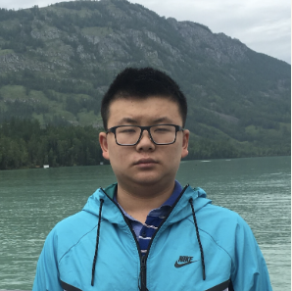



Lifting Linear Sketches: Optimal Bounds and Adversarial Robustness
Elena Gribelyuk
Princeton
Honghao Lin
CMU
David P. Woodruff
CMU
Huacheng Yu
Princeton
Samson Zhou
Texas A&M

Slide 2



Streaming Model
Massive Data Streams
Internet traffics
Sensor networks
Stock markets

Slide 3
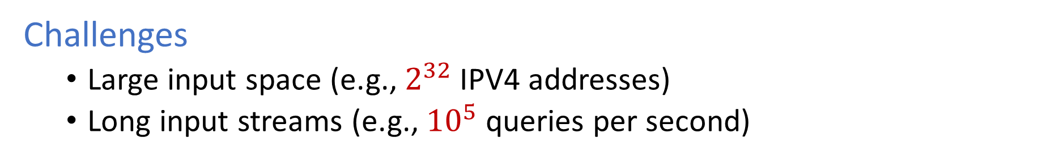
Streaming Model
Massive Data Streams
Internet traffics
Sensor networks
Stock markets
Challenges
Large input space (e.g., $2^{32}$ IPV4 addresses)
Long input streams (e.g., ${10}^{5}$ queries per second)

Slide 4

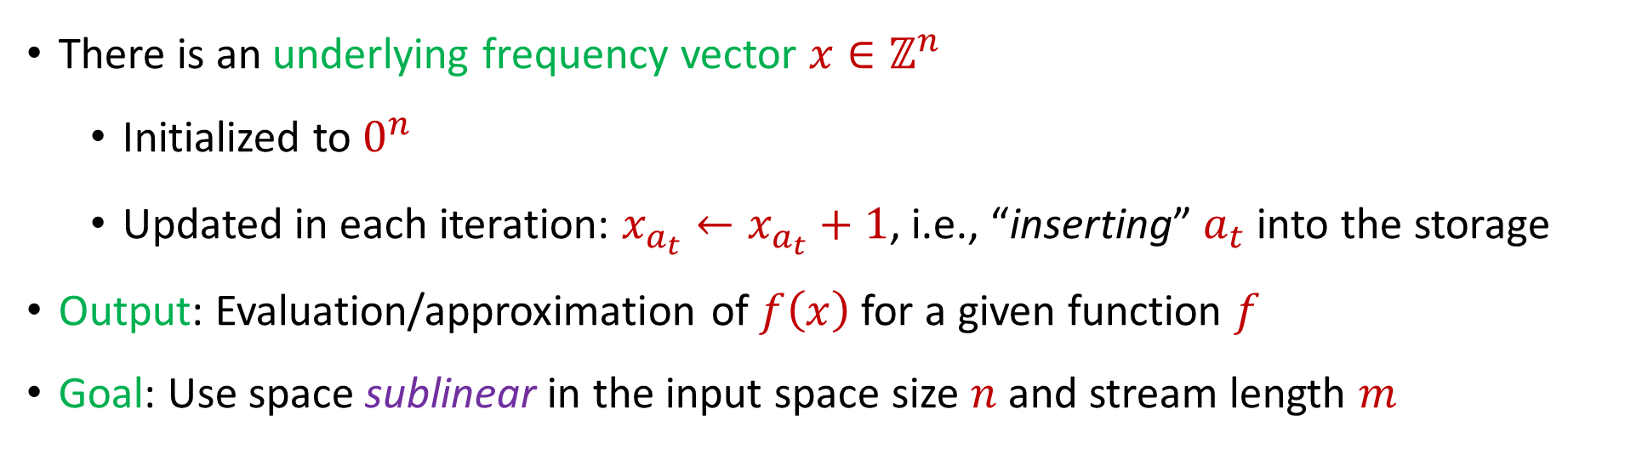
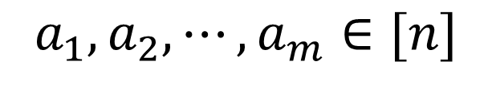
Streaming Model
$$a_{1}, a_{2}, ⋯, a_{m}∈[n]$$
There is an underlying frequency vector $x∈ℤ^{n}$
Initialized to $0^{n}$
Updated in each iteration: $x_{a_{t}}←x_{a_{t}}+1$, i.e., “inserting” $a_{t}$ into the storage
Output: Evaluation/approximation of $f\left(x\right)$ for a given function $f$
Goal: Use space sublinear in the input space size $n$ and stream length $m$

Slide 5
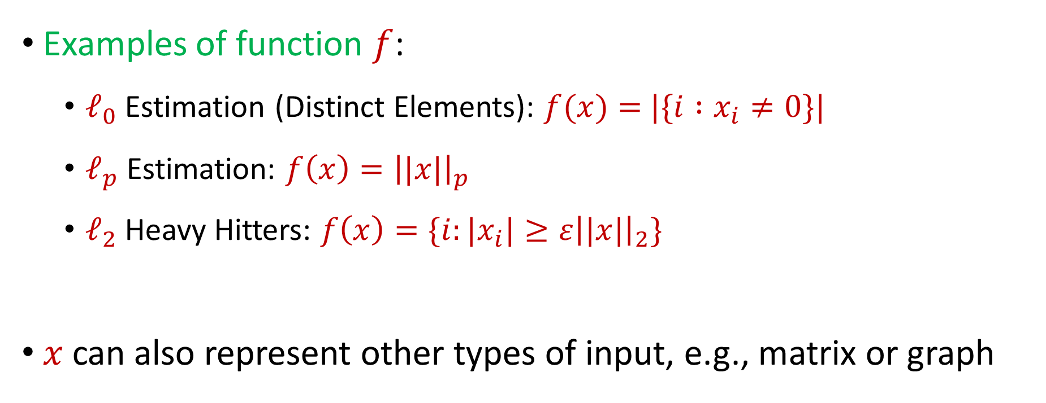
Streaming Model
Examples of function $f$:
$ℓ_{0}$Estimation (Distinct Elements): $f(x)=$ $|\{i :x_{i}≠0\}|$
$ℓ_{p}$Estimation: $f\left(x\right)={\left||x|\right|}_{p}$
$ℓ_{2}$Heavy Hitters: $f\left(x\right)=\{i:|x_{i}|≥ε{\left||x|\right|}_{2}\}$
$x$ can also represent other types of input, e.g., matrix or graph

Slide 6
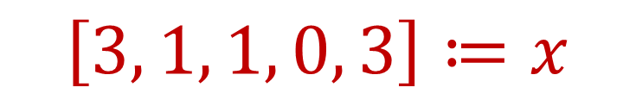
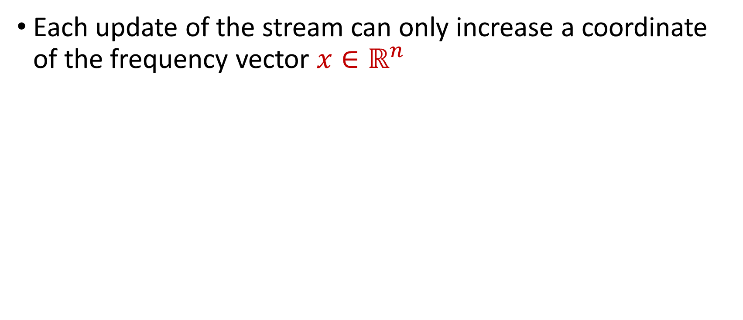
Example
Each update of the stream can only increase a coordinate of the frequency vector $x∈ℝ^{n}$
1 5 2 1 3 5 5 1 
$$\left[3, 1, 1, 0, 3\right]≔x$$
4 Distinct Elements

Slide 7
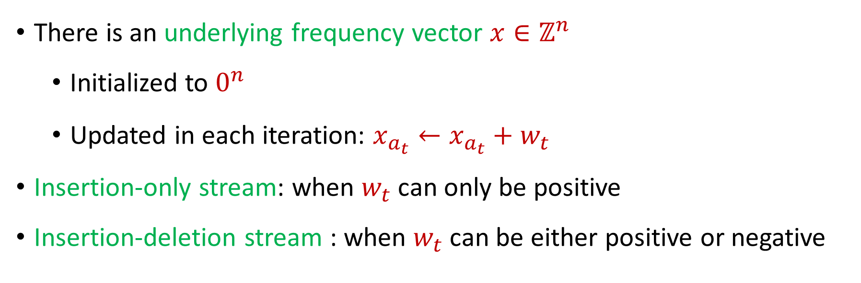
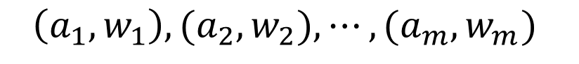
Streaming Model
$$\left(a_{1}, w_{1}\right), {(a}_{2}, w_{2}), ⋯, {(a}_{m}, w_{m})$$
There is an underlying frequency vector $x∈ℤ^{n}$
Initialized to $0^{n}$
Updated in each iteration: $x_{a_{t}}←x_{a_{t}}+w_{t}$
Insertion-only stream: when $w_{t}$can only be positive
Insertion-deletion stream : when $w_{t}$ can be either positive or negative

Slide 8
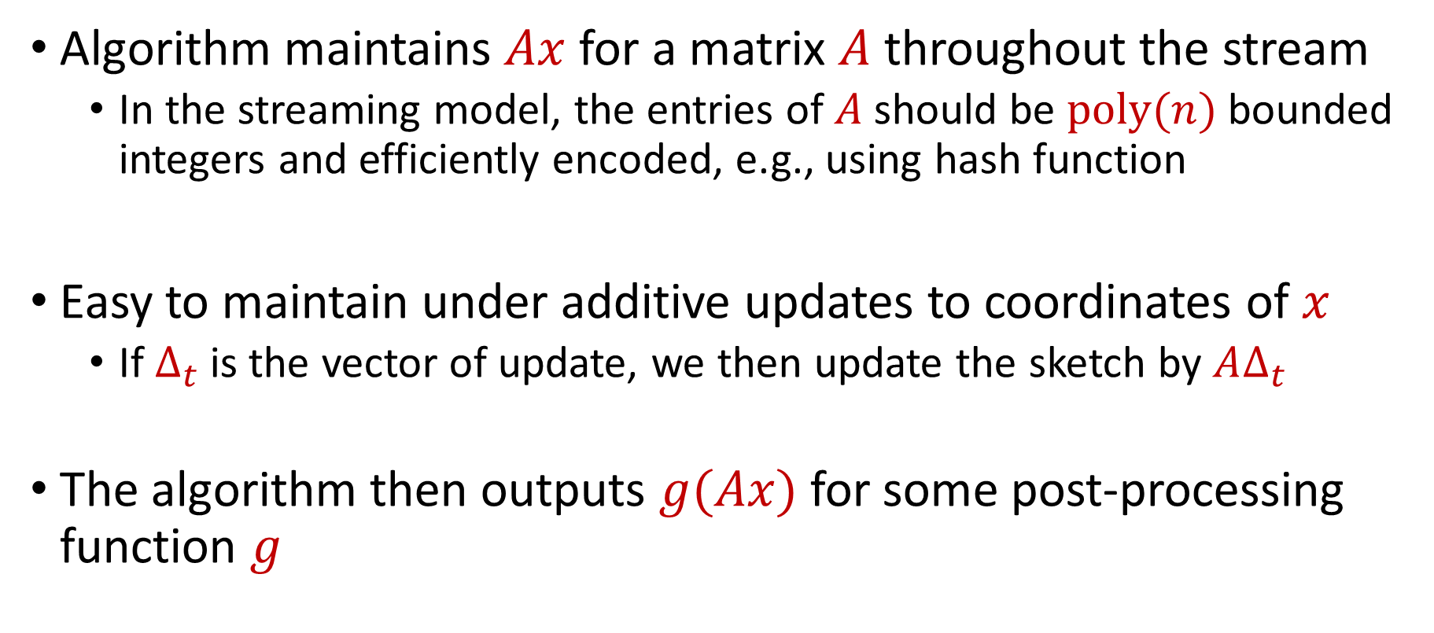
Linear Sketch
Algorithm maintains $Ax$ for a matrix $A$ throughout the stream
In the streaming model, the entries of $A$should be $poly(n)$bounded integers and efficiently encoded, e.g., using hash function
Easy to maintain under additive updates to coordinates of $x$
If $Δ_{t}$ is the vector of update, we then update the sketch by $AΔ_{t}$
The algorithm then outputs $g(Ax)$ for some post-processing function $g$

Slide 9
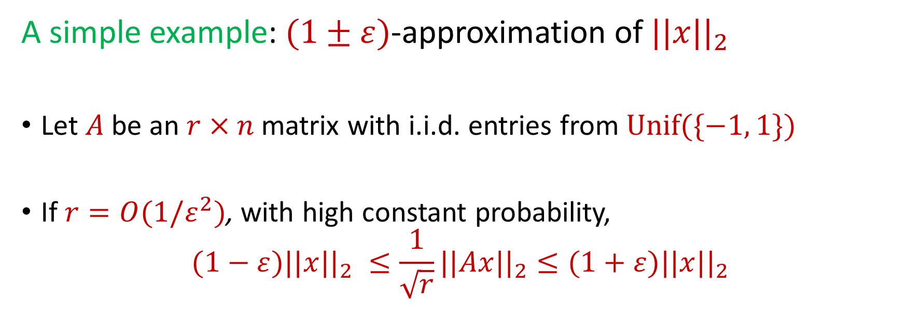
Linear Sketch
A simple example: $(1±ε)$-approximation of $||x{||}_{2}$
Let $A$be an $r×n$ matrix with i.i.d. entries from $Unif(\{−1, 1\})$
If $r=O(1/ε^{2})$, with high constant probability,
$$(1−ε)||x{||}_{2} ≤\frac{1}{\sqrt{r}}||Ax{||}_{2}≤(1+ε)||x{||}_{2}$$

Slide 10
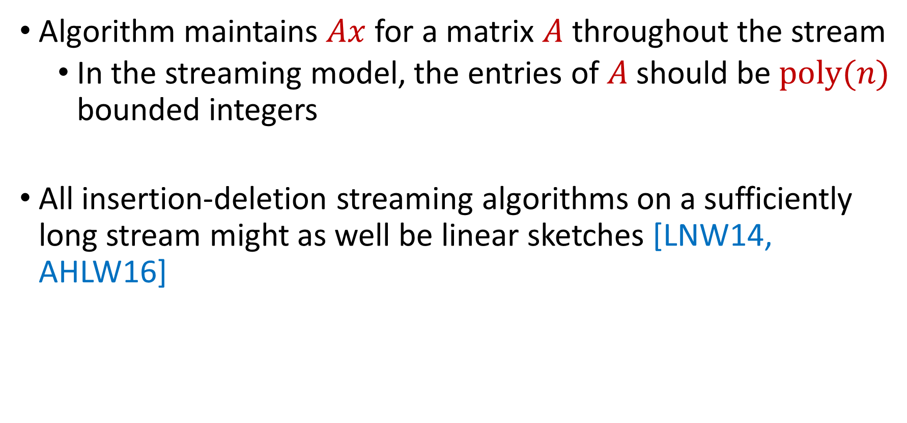
Linear Sketch
Algorithm maintains $Ax$ for a matrix $A$ throughout the stream
In the streaming model, the entries of $A$should be $poly(n)$ bounded integers
All insertion-deletion streaming algorithms on a sufficiently long stream might as well be linear sketches [LNW14, AHLW16]

Slide 11
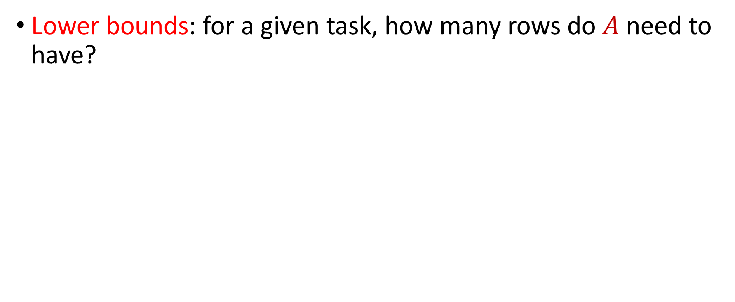
Linear Sketch
Lower bounds: for a given task, how many rows do $A$ need to have?

Slide 12
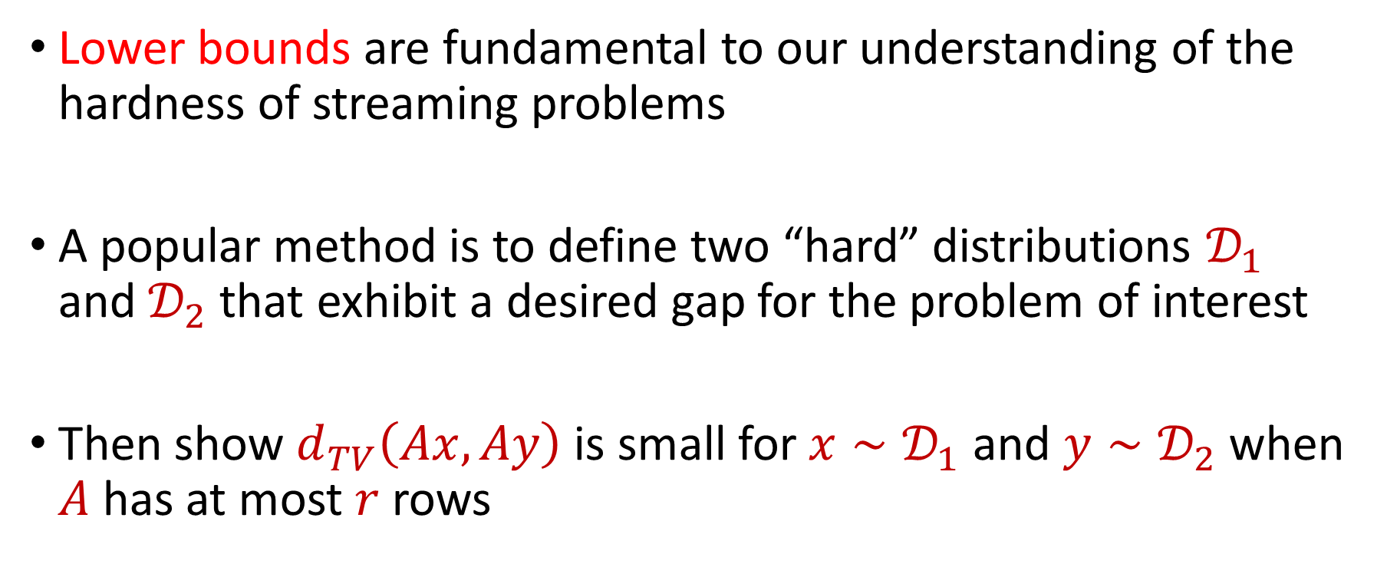
Linear Sketch
Lower bounds are fundamental to our understanding of the hardness of streaming problems
A popular method is to define two “hard” distributions $𝒟_{1}$ and $𝒟_{2}$that exhibit a desired gap for the problem of interest
Then show $d_{TV}\left(Ax, Ay\right)$ is small for ${x∼𝒟}_{1}$ and $y∼𝒟_{2}$ when $A$ has at most $r$ rows

Slide 13
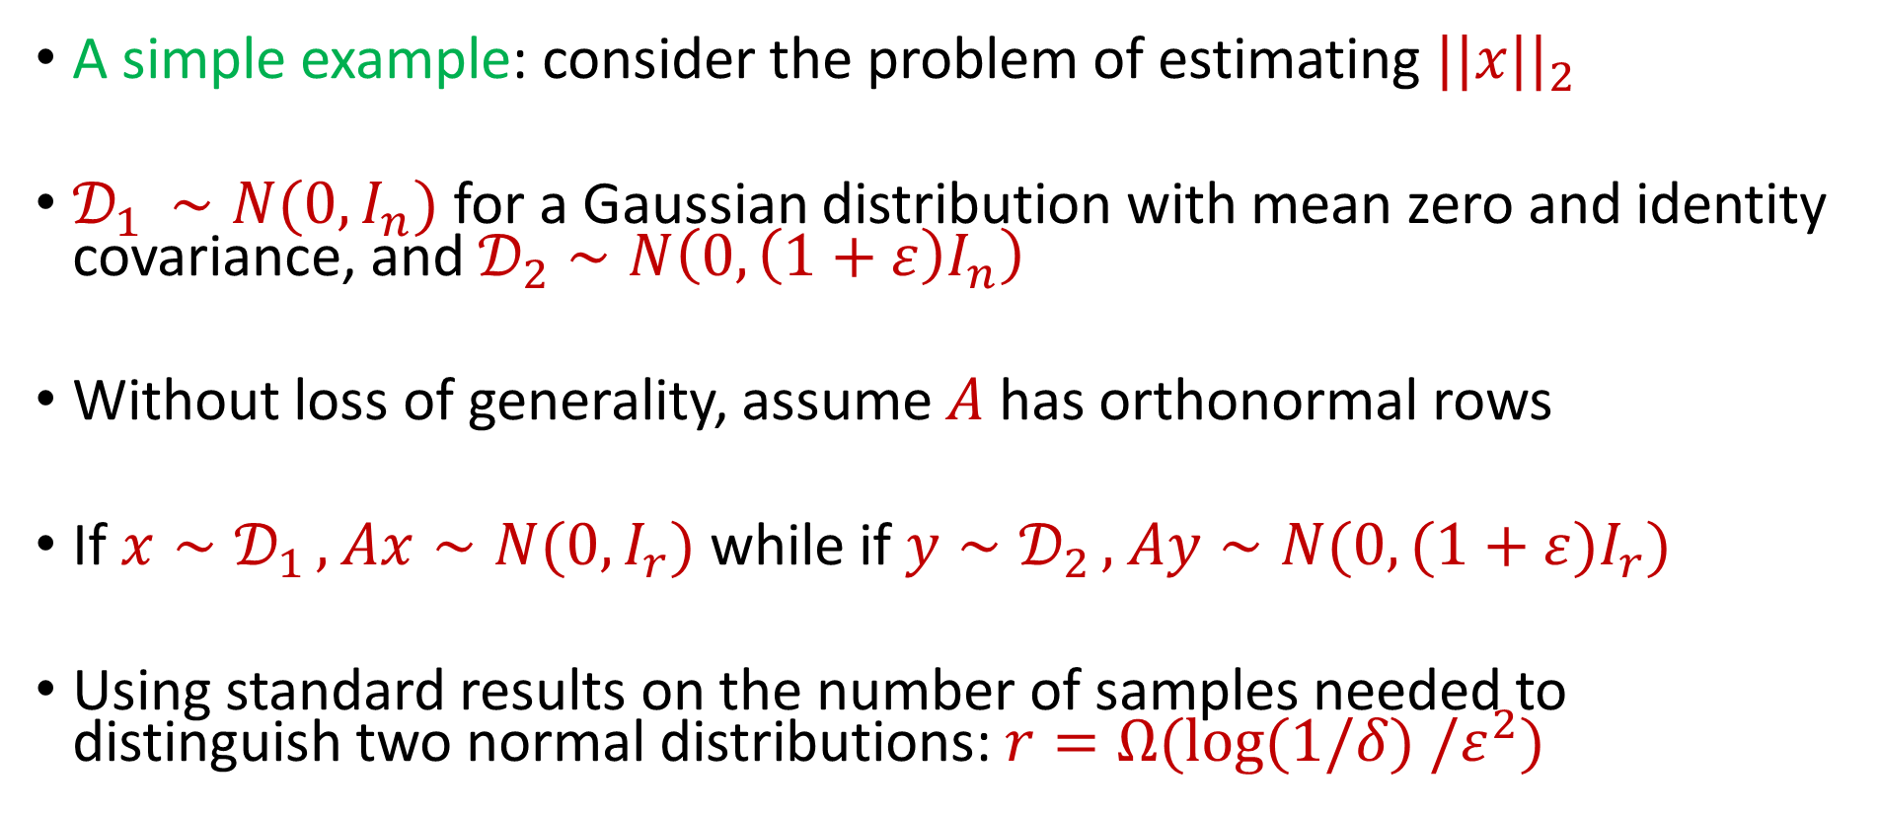
Linear Sketch
A simple example: consider the problem of estimating $||x{||}_{2}$
$𝒟_{1 }∼N(0, I_{n})$ for a Gaussian distribution with mean zero and identity covariance, and $𝒟_{2}∼N\left(0, {\left(1+ε\right)I}_{n}\right)$
Without loss of generality, assume $A$ has orthonormal rows
If $x∼𝒟_{1 },$ $Ax∼N(0, I_{r})$ while if $y∼𝒟_{2 },$ $Ay∼N(0, (1+ε)I_{r})$
Using standard results on the number of samples needed to distinguish two normal distributions: $r=Ω(log(1/δ) /ε^{2})$

Slide 14
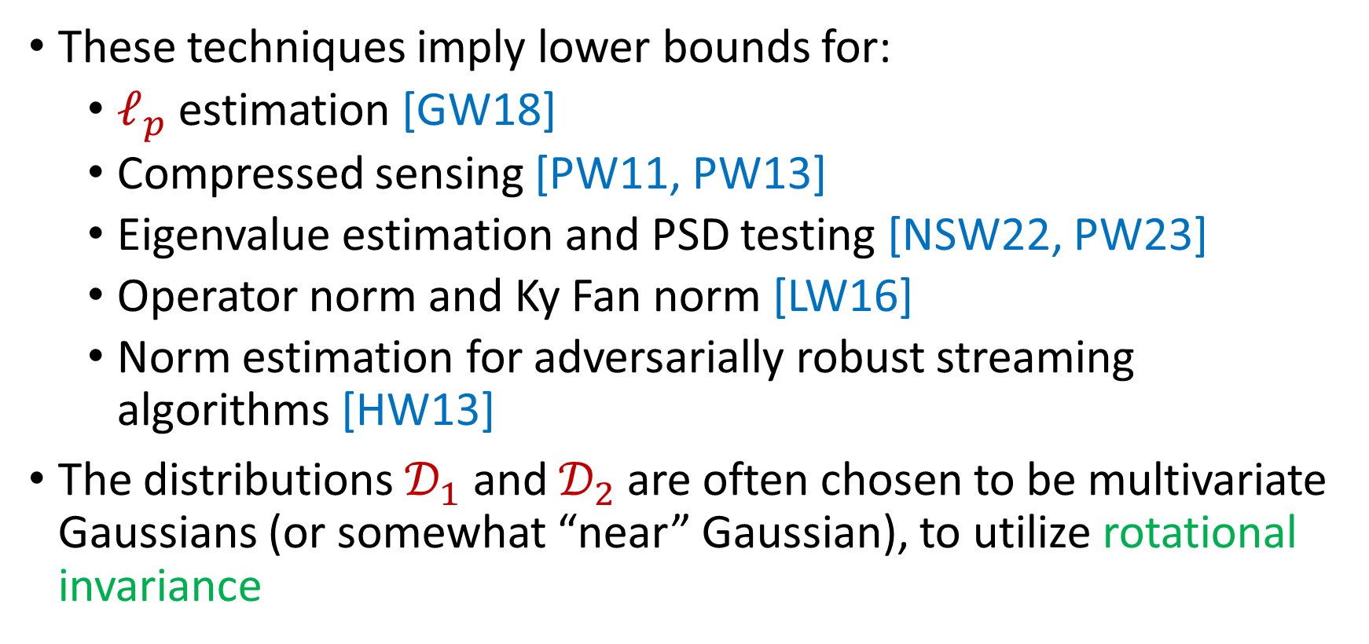
Linear Sketch
These techniques imply lower bounds for:
$ℓ_{p}$ estimation [GW18]
Compressed sensing [PW11, PW13]
Eigenvalue estimation and PSD testing [NSW22, PW23]
Operator norm and Ky Fan norm [LW16]
Norm estimation for adversarially robust streaming algorithms [HW13]
The distributions $𝒟_{1}$ and $𝒟_{2}$are often chosen to be multivariate Gaussians (or somewhat “near” Gaussian), to utilize rotational invariance
Notes:
o

Slide 15
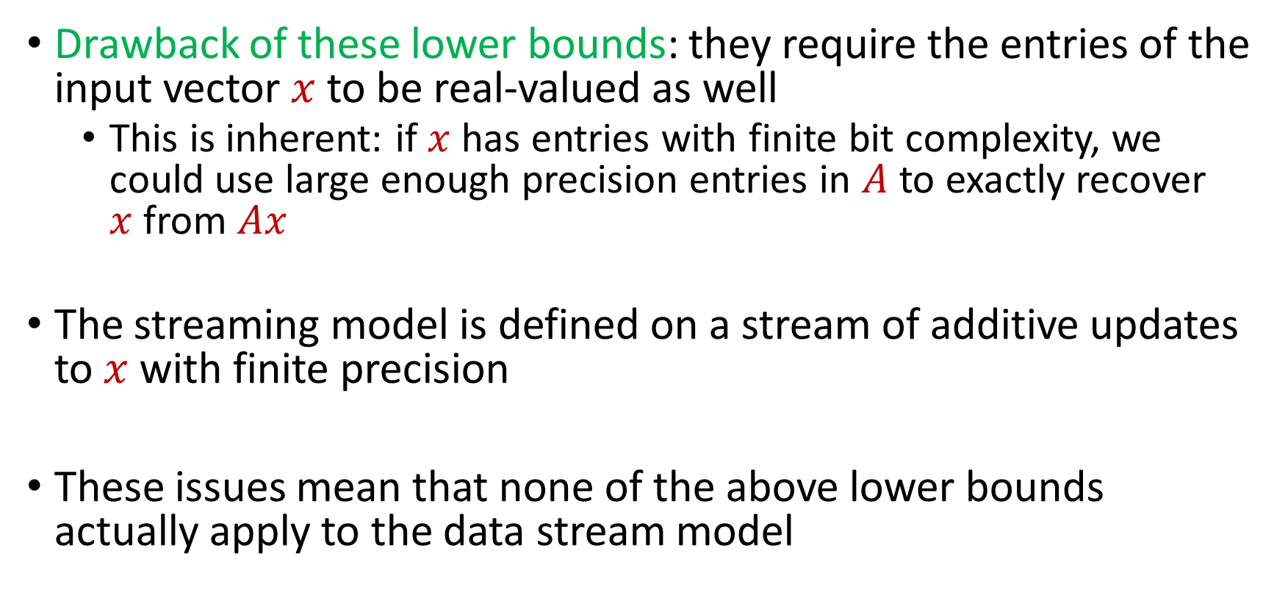
Linear Sketch
Drawback of these lower bounds: they require the entries of the input vector $x$to be real-valued as well
This is inherent: if $x$has entries with finite bit complexity, we could use large enough precision entries in $A$ to exactly recover $x$from $Ax$
The streaming model is defined on a stream of additive updates to $x$with finite precision
These issues mean that none of the above lower bounds actually apply to the data stream model

Slide 16
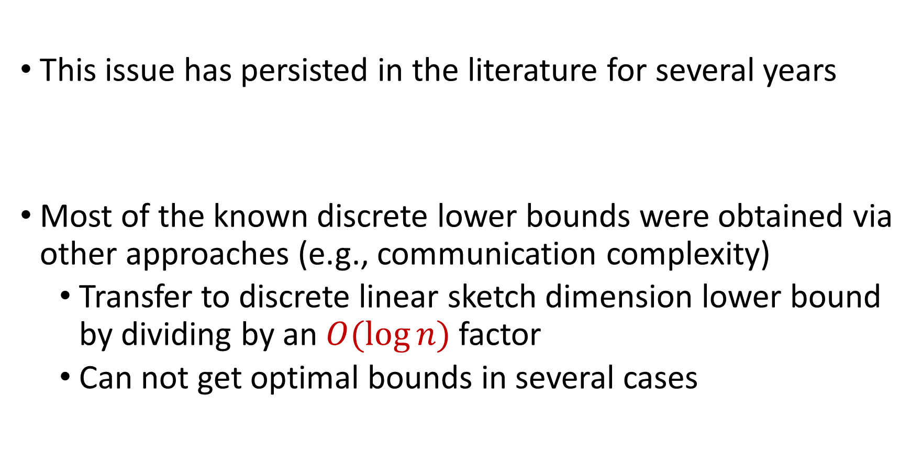
Linear Sketch
This issue has persisted in the literature for several years
Most of the known discrete lower bounds were obtained via other approaches (e.g., communication complexity)
Transfer to discrete linear sketch dimension lower bound by dividing by an $O(\log{n})$ factor
Can not get optimal bounds in several cases

Slide 17
Linear Sketch
Idea: e.g., one could try to discretize the input distribution to the above problem
Difficulty: the distribution is no longer rotationally invariant, and a priori it is not clear that information about the input is revealed by truncating low order bits
Question 1: Is it possible to lift linear sketch lower bounds for continuous inputs to obtain linear sketch lower bounds for discrete inputs?

Slide 18
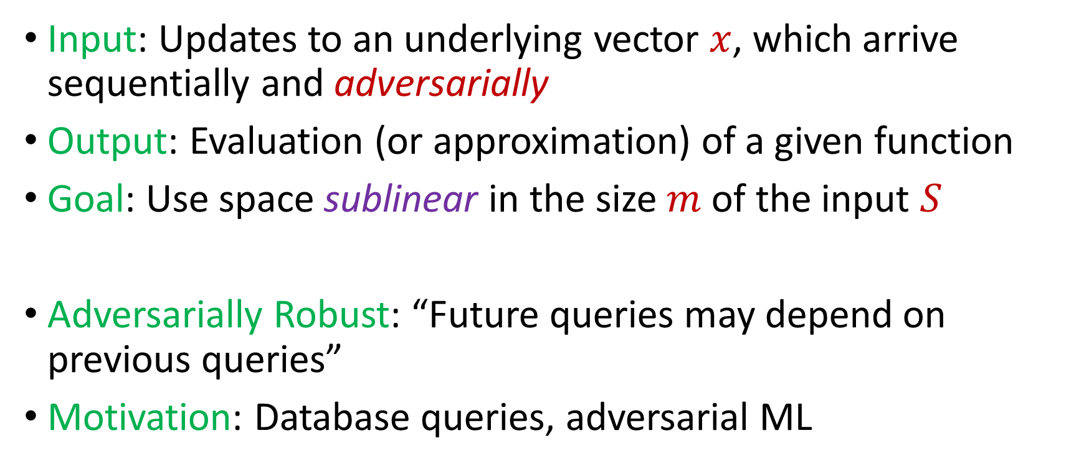
Adversarially Robust Streaming
Input: Updates to an underlying vector $x$, which arrive sequentially and adversarially
Output: Evaluation (or approximation) of a given function
Goal: Use space sublinear in the size $m$ of the input $S$
Adversarially Robust: “Future queries may depend on previous queries”
Motivation: Database queries, adversarial ML
Notes:
Let’s start by breaking down each of the terms in the title. To understand the sliding window model, we first have to understand the streaming model of computation, in which elements of an underlying data set S, arrive sequentially and the goal is to evaluate or approximate some given function on this dataset, using space sublinear in S. In the sliding window model, only the W most recent updates form the underlying data set

Slide 19


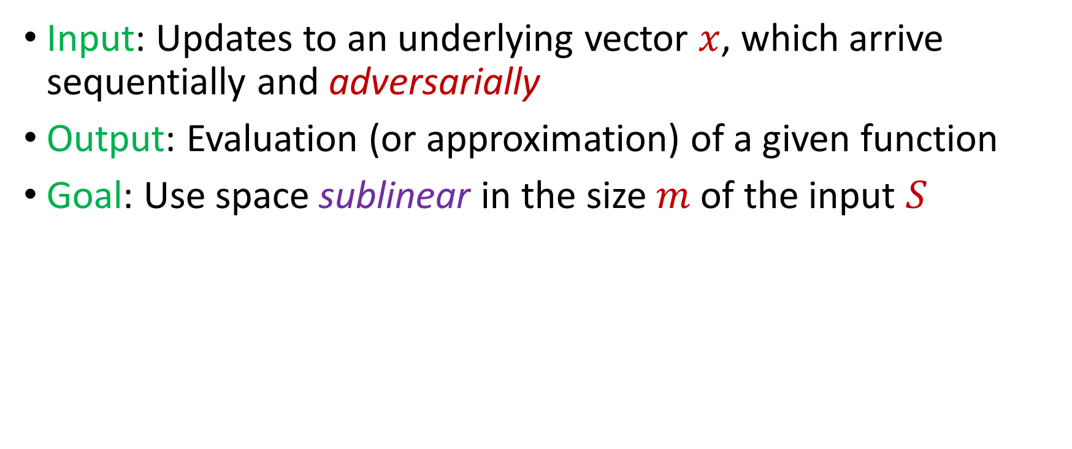
Adversarially Robust Streaming
Input: Updates to an underlying vector $x$, which arrive sequentially and adversarially
Output: Evaluation (or approximation) of a given function
Goal: Use space sublinear in the size $m$ of the input $S$
Attacker
Algorithm
Notes:
Alg是l0 alg

Slide 20
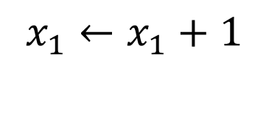
Adversarially Robust Streaming
Input: Updates to an underlying vector $x$, which arrive sequentially and adversarially
Output: Evaluation (or approximation) of a given function
Goal: Use space sublinear in the size $m$ of the input $S$
$$x_{1}←x_{1}+1$$
1
Attacker
Algorithm

Slide 21
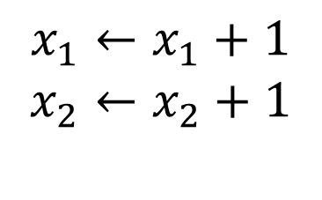
Adversarially Robust Streaming
Input: Updates to an underlying vector $x$, which arrive sequentially and adversarially
Output: Evaluation (or approximation) of a given function
Goal: Use space sublinear in the size $m$of the input $S$
$$x_{1}←x_{1}+1$$
$$x_{2}←x_{2}+1$$
2
Attacker
Algorithm

Slide 22
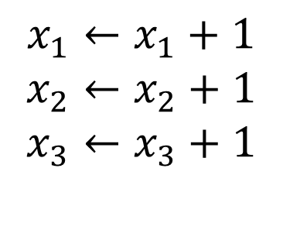
Adversarially Robust Streaming
Input: Updates to an underlying vector $x$, which arrive sequentially and adversarially
Output: Evaluation (or approximation) of a given function
Goal: Use space sublinear in the size $m$of the input $S$
$$x_{1}←x_{1}+1$$
$$x_{2}←x_{2}+1$$
$$x_{3}←x_{3}+1$$
3
Attacker
Algorithm

Slide 23
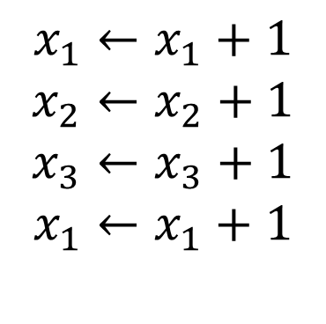
Adversarially Robust Streaming
Input: Updates to an underlying vector $x$, which arrive sequentially and adversarially
Output: Evaluation (or approximation) of a given function
Goal: Use space sublinear in the size $m$of the input $S$
$$x_{1}←x_{1}+1$$
$$x_{2}←x_{2}+1$$
$$x_{3}←x_{3}+1$$
$$x_{1}←x_{1}+1$$
4
Attacker
Algorithm

Slide 24

Adversarially Robust Streaming
Input: Updates to an underlying vector $x$, which arrive sequentially and adversarially
Output: Evaluation (or approximation) of a given function
Goal: Use space sublinear in the size $m$of the input $S$
$$x_{1}←x_{1}+1$$
$$x_{2}←x_{2}+1$$
$$x_{3}←x_{3}+1$$
$$x_{1}←x_{1}+1$$
4
Attacker
Algorithm
Notes:
adversarially

Slide 25
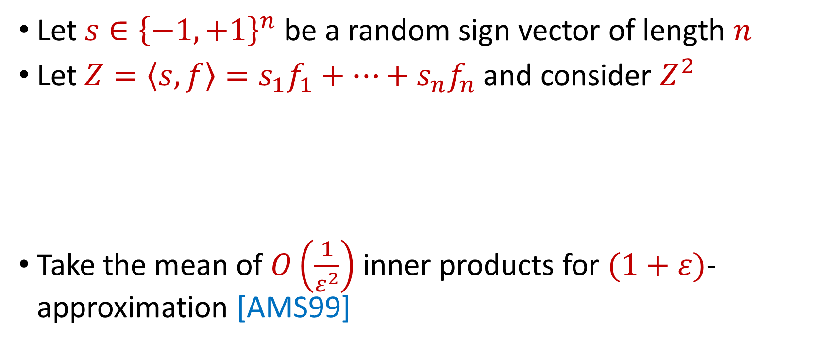

AMS $F_{2}$Algorithm
Let $s∈{\left\{−1,+1\right\}}^{n}$ be a random sign vector of length $n$
Let $Z=\left\langle s,f\right\rangle =s_{1}f_{1}+…+s_{n}f_{n}$ and consider $Z^{2}$
Take the mean of $O\left(\frac{1}{ε^{2}}\right)$ inner products for $(1+ε)$-approximation [AMS99]
$E\left[Z^{2}\right]=$ $\sum_{i,j}{E\left[s_{i}s_{j}f_{i}f_{j}\right]}=f_{1}^{2}+…+f_{n}^{2}$
$Var\left[Z^{2}\right]≤$ $\sum_{i,j}{E\left[s_{i}s_{j}s_{k}s_{l}f_{i}f_{j}f_{k}f_{l}\right]}≤6F_{2}^{2}$

Slide 26
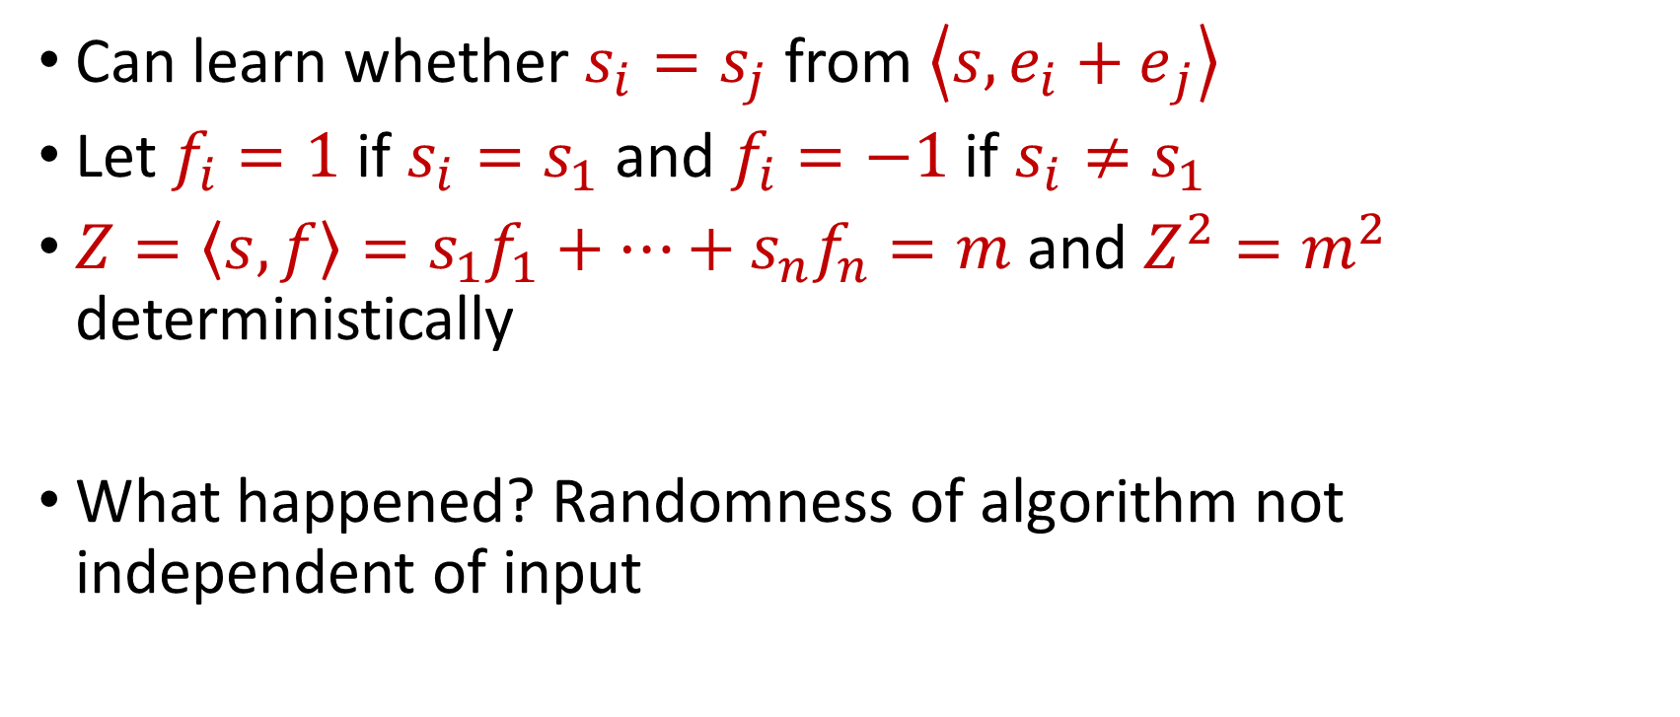
“Attack” on AMS
Can learn whether $s_{i}=s_{j}$ from $\left\langle s,{e_{i}+e}_{j}\right\rangle$
Let $f_{i}=1$ if $s_{i}=s_{1}$ and $f_{i}=−1$ if $s_{i}≠s_{1}$
$Z=\left\langle s,f\right\rangle =s_{1}f_{1}+…+s_{n}f_{n}=m$ and $Z^{2}=m^{2}$ deterministically
What happened? Randomness of algorithm not independent of input

Slide 27
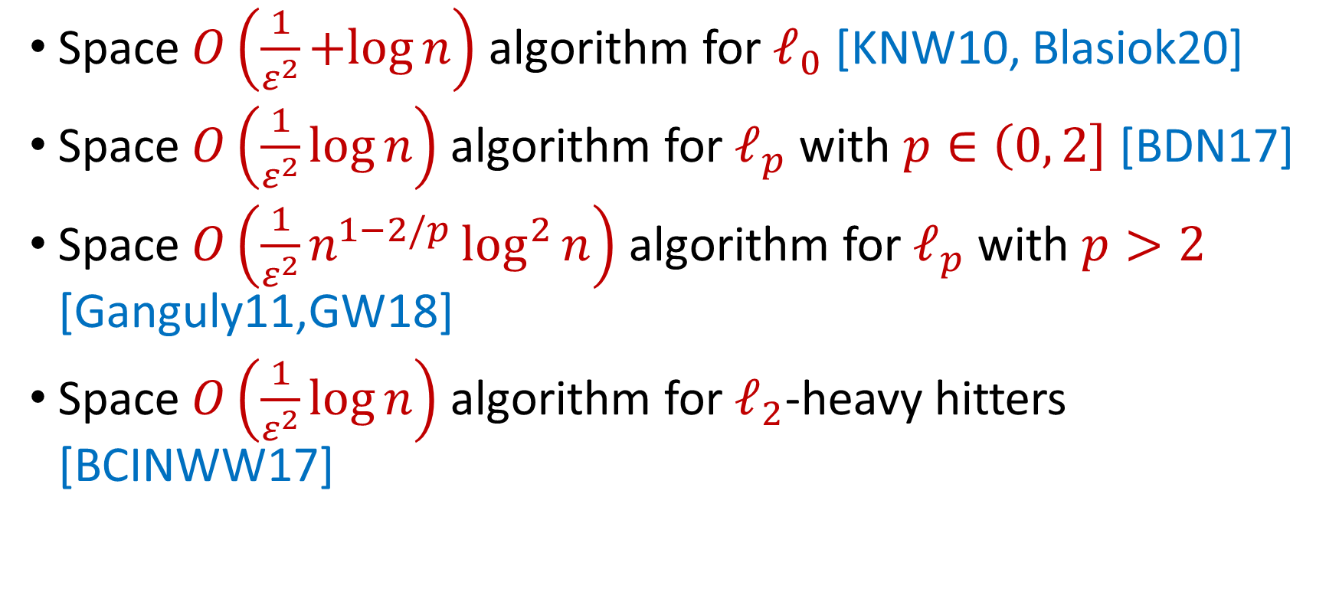
Classic Insertion-Only Algorithms
Space $O\left(\frac{1}{ε^{2}}+log{n}\right)$ algorithm for $ℓ_{0}$ [KNW10, Blasiok20]
Space $O\left(\frac{1}{ε^{2}}\log{n}\right)$ algorithm for $ℓ_{p}$ with $p∈\left(0, 2\right]$ [BDN17]
Space $O\left(\frac{1}{ε^{2}}n^{1−2/p}\log^{2}{n}\right)$ algorithm for $ℓ_{p}$ with $p>2$ [Ganguly11,GW18]
Space $O\left(\frac{1}{ε^{2}}\log{n}\right)$ algorithm for $ℓ_{2}$-heavy hitters [BCINWW17]

Slide 28
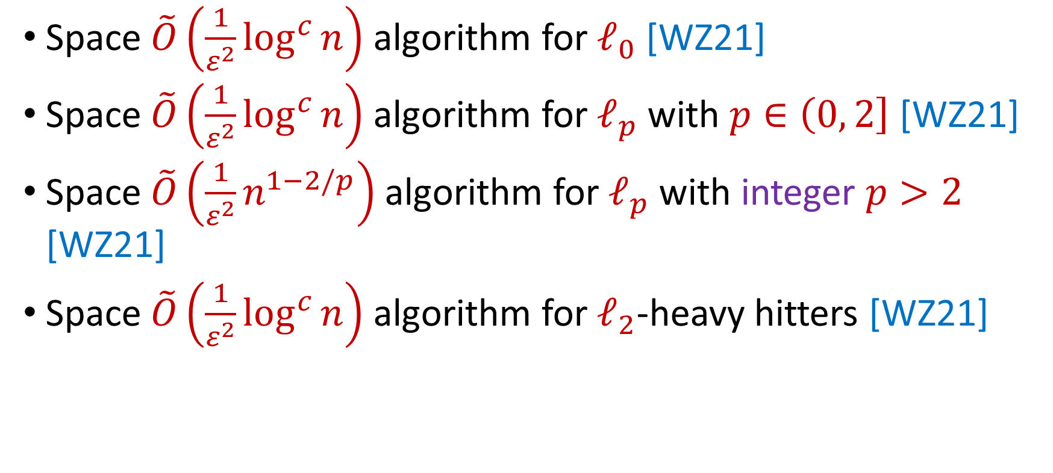
Robust Insertion-Only Algorithms
Space $\tilde{O}\left(\frac{1}{ε^{2}}\log^{c}{n}\right)$ algorithm for $ℓ_{0}$ [WZ21]
Space $\tilde{O}\left(\frac{1}{ε^{2}}\log^{c}{n}\right)$ algorithm for $ℓ_{p}$ with $p∈\left(0, 2\right]$ [WZ21]
Space $\tilde{O}\left(\frac{1}{ε^{2}}n^{1−2/p}\right)$ algorithm for $ℓ_{p}$ with integer $p>2$ [WZ21]
Space $\tilde{O}\left(\frac{1}{ε^{2}}\log^{c}{n}\right)$ algorithm for $ℓ_{2}$-heavy hitters [WZ21]
“No losses* are necessary!”
*up to poly-logarithmic factors

Slide 29
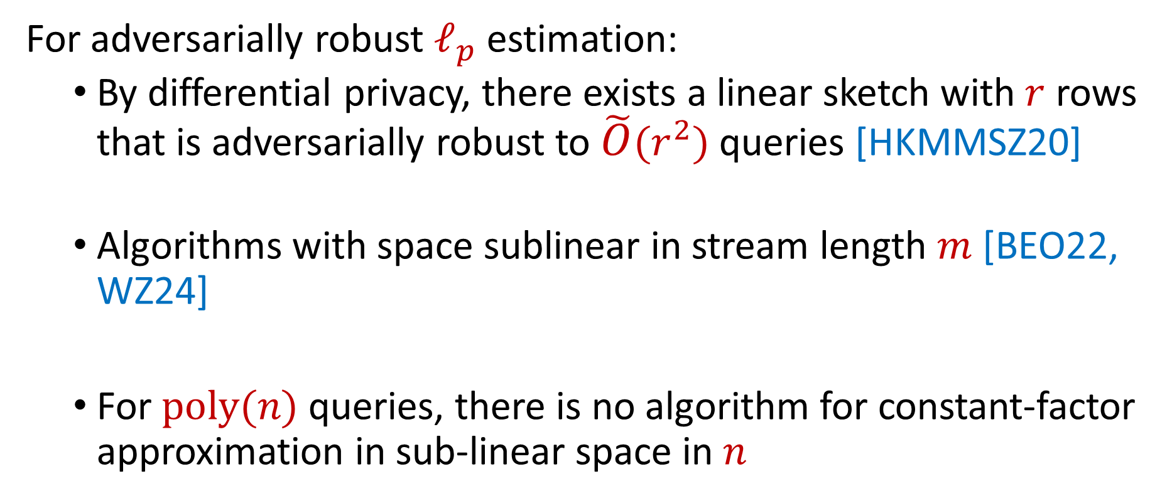
Robust Insertion-Deletion Streams
For adversarially robust $ℓ_{p}$ estimation:
By differential privacy, there exists a linear sketch with $r$ rows that is adversarially robust to $\tilde{O}(r^{2})$ queries [HKMMSZ20]
Algorithms with space sublinear in stream length $m$ [BEO22, WZ24]
For $poly(n)$ queries, there is no algorithm for constant-factor approximation in sub-linear space in $n$
Notes:
Practice

Slide 30
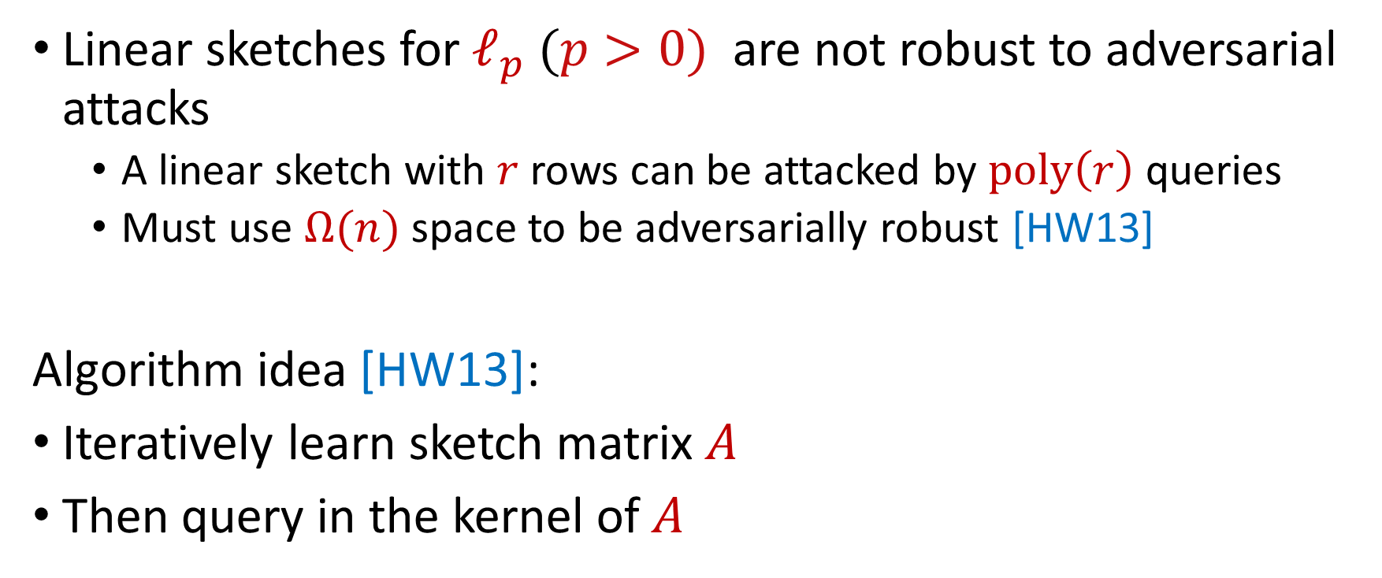
Reconstruction Attack on Linear Sketches
Linear sketches for $ℓ_{p} (p>0)$ are not robust to adversarial attacks
A linear sketch with $r$rows can be attacked by $poly\left(r\right)$ queries
Must use $Ω(n)$ space to be adversarially robust [HW13]
Algorithm idea [HW13]:
Iteratively learn sketch matrix $A$
Then query in the kernel of $A$

Slide 31
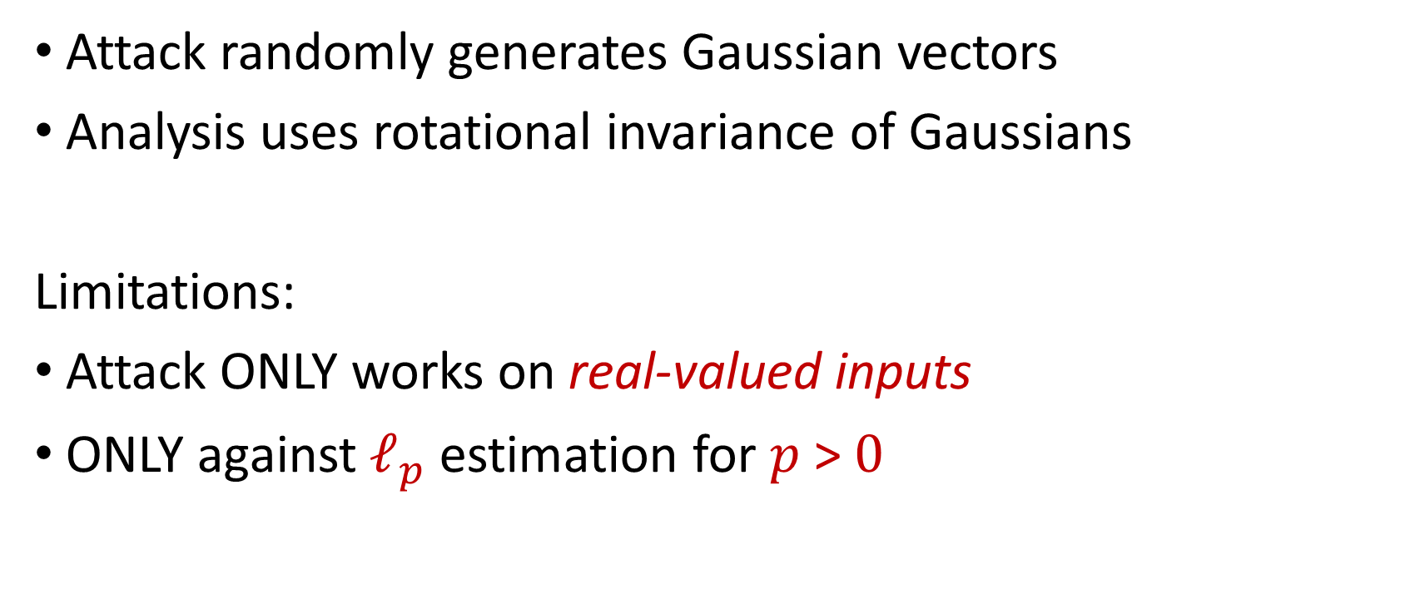
Reconstruction Attack on Linear Sketches
Attack randomly generates Gaussian vectors
Analysis uses rotational invariance of Gaussians
Limitations:
Attack ONLY works on real-valued inputs
ONLY against $ℓ_{p}$ estimation for $p$ > $0$

Slide 32
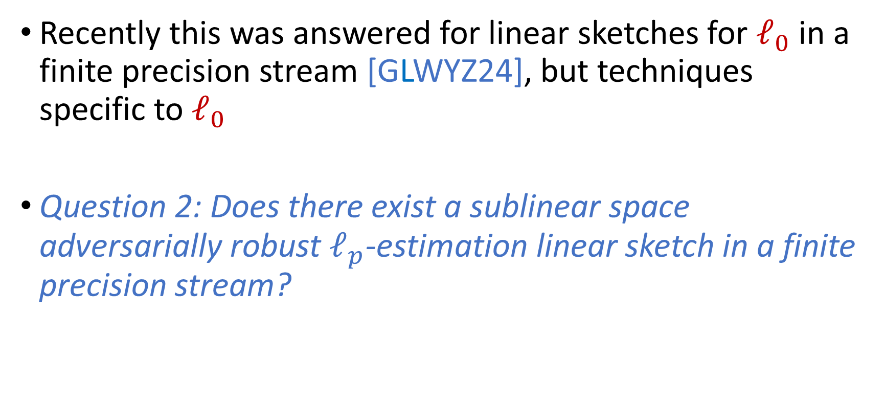
Reconstruction Attack on Linear Sketches
Recently this was answered for linear sketches for $ℓ_{0}$ in a finite precision stream [GLWYZ24], but techniques specific to $ℓ_{0}$
Question 2: Does there exist a sublinear space adversarially robust $ℓ_{p}$-estimation linear sketch in a finite precision stream?

Slide 33
We give a technique for lifting linear sketch lower bounds for continuous inputs to achieve linear sketch lower bounds for discrete inputs, thus answering the previous open questions

Slide 34
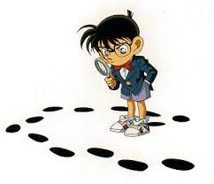
Questions?
Upcoming
Pre-processing for lifting framework

Slide 35
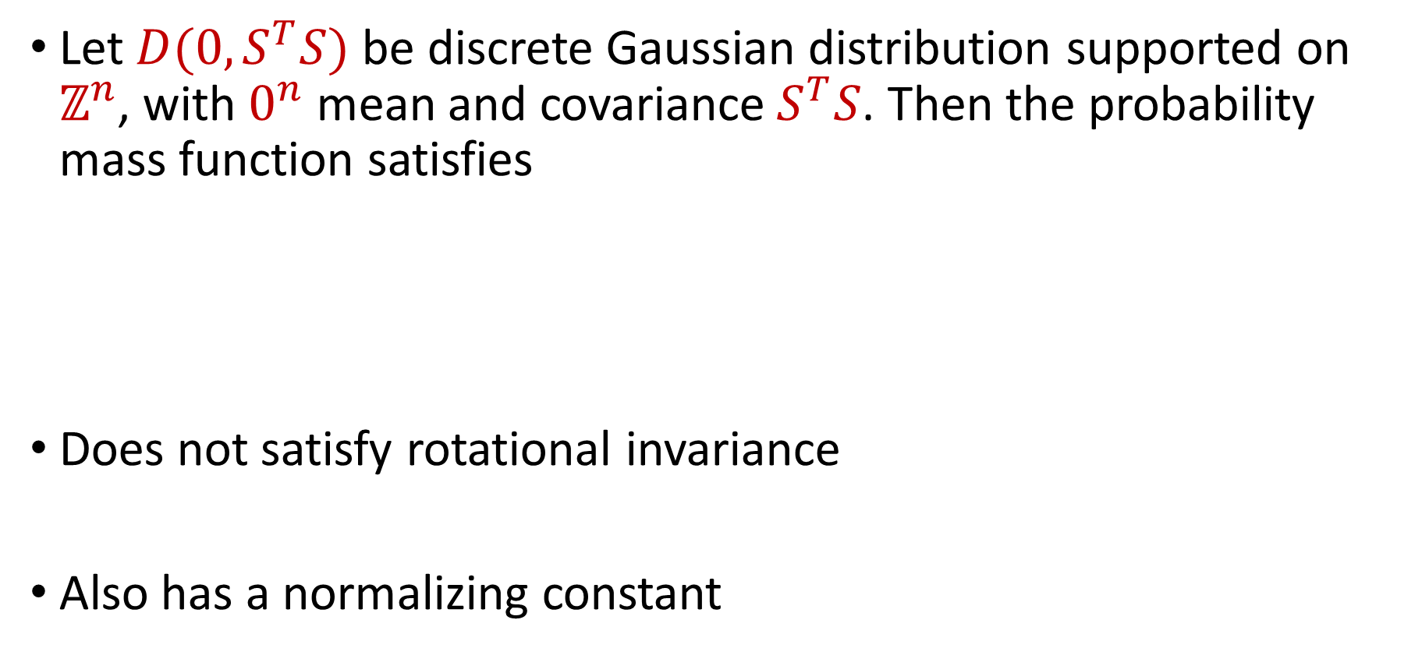
Discrete Gaussian Distribution
Let $D(0, S^{T}S)$ be discrete Gaussian distribution supported on $ℤ^{n}$, with $0^{n}$ mean and covariance${ S}^{T}S$. Then the probability mass function satisfies
Does not satisfy rotational invariance
Also has a normalizing constant
$$\underset{X\sim D\left(0,S^{T}S\right)}{Pr}\left[X=x\right]∝exp{\left(−x^{T}(2S^{T}S\right)}^{−1}x)$$

Slide 36
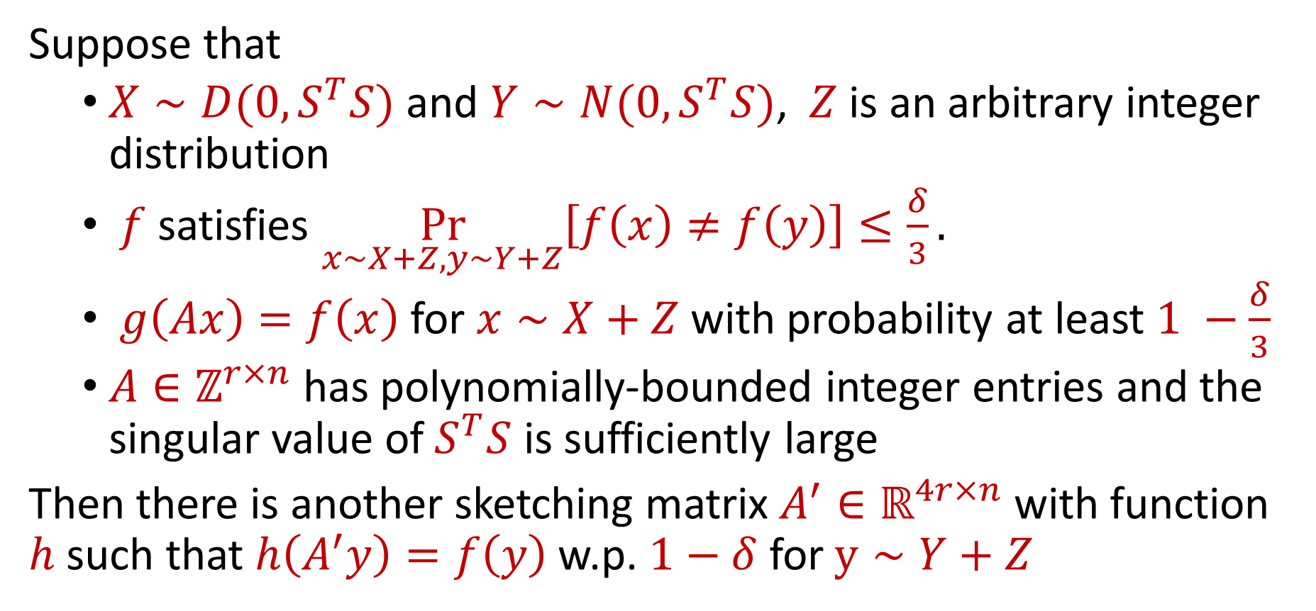
Our Results (Lifting Framework)
Suppose that
$X∼D(0, S^{T}S)$ and $Y∼N(0, S^{T}S)$, $Z$ is an arbitrary integer distribution
$f$ satisfies $\underset{x∼X+Z, y∼Y+Z}{Pr}\left[f\left(x\right)≠f\left(y\right)\right]≤\frac{δ}{3}.$
$g\left(Ax\right)=f\left(x\right)$ for $x∼X+Z$with probability at least $1 −\frac{δ}{3}$
$A∈ℤ^{r×n}$ has polynomially-bounded integer entries and the singular value of $S^{T}S$ is sufficiently large
Then there is another sketching matrix $A^{′}∈ℝ^{4r×n}$ with function $h$ such that $h\left(A^{′}y\right)=f\left(y\right)$w.p. $1−δ$ for $y∼Y+Z$

Slide 37

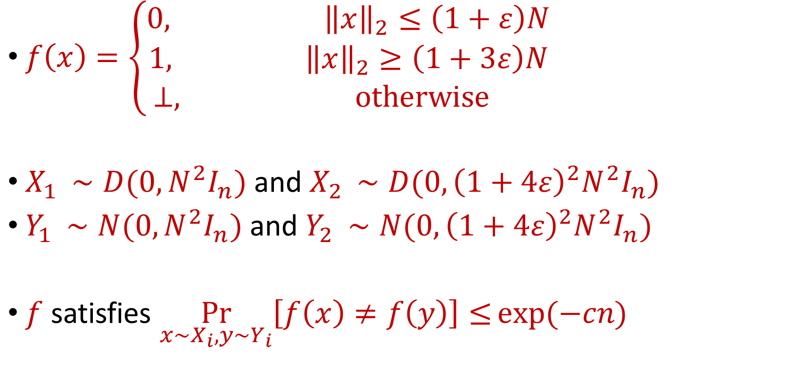
Example Problem ($ℓ_{2 }$Estimation)
$f\left(x\right)=\left\{\begin{aligned}0, {\left\|x\right\|}_{2}≤\left(1+ε\right)N \\ 1, {\left\|x\right\|}_{2}≥\left(1+3ε\right)N \\ ⊥, otherwise \end{aligned}\right.$
$X_{1 }∼D(0, {N^{2}I}_{n})$ and $X_{2 }∼D(0, {{{\left(1+4ε\right)}^{2}N}^{2}I}_{n})$
$Y_{1 }∼N(0, {N^{2}I}_{n})$ and $Y_{2 }∼N(0, {{{\left(1+4ε\right)}^{2}N}^{2}I}_{n})$
$f$ satisfies $\underset{x∼X_{i}, y∼Y_{i}}{Pr}\left[f\left(x\right)≠f\left(y\right)\right]≤exp(−cn)$
Notes:
N is a large polynomial in n, bounds due to tail bounds on chi squared distribution

Slide 38
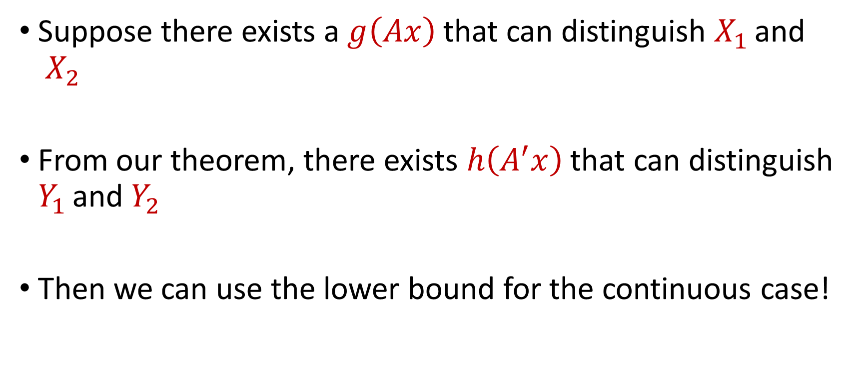
Example Problem ($ℓ_{2 }$Estimation)
Suppose there exists a $g\left(Ax\right)$ that can distinguish $X_{1 }$and $X_{2 }$
From our theorem, there exists $h\left(A^{′}x\right)$ that can distinguish $Y_{1 }$and $Y_{2 }$
Then we can use the lower bound for the continuous case!

Slide 39
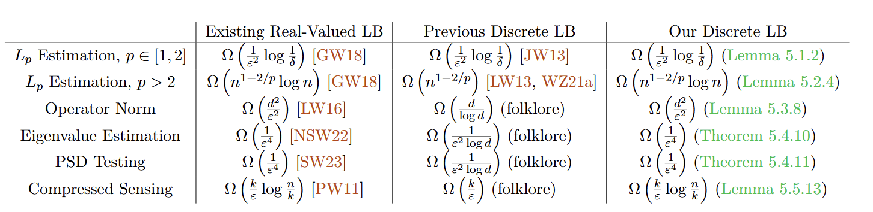
Our Results (Applications)
We apply our lifting technique to obtain optimal lower bounds:

Slide 40
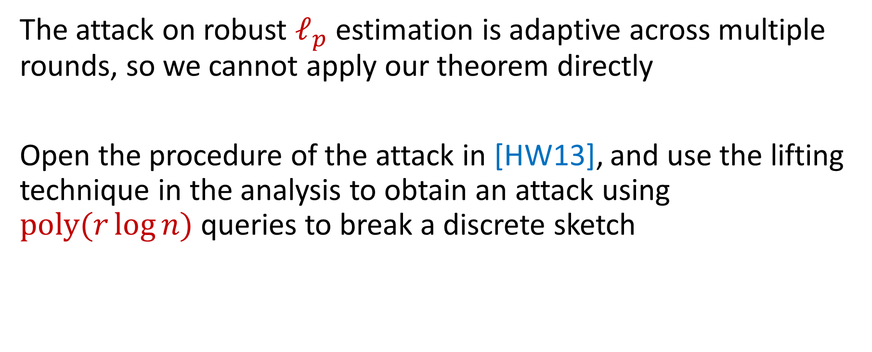
Our Results (Adversarial Robustness)
The attack on robust $ℓ_{p}$ estimation is adaptive across multiple rounds, so we cannot apply our theorem directly
Open the procedure of the attack in [HW13], and use the lifting technique in the analysis to obtain an attack using $poly(r\log{n})$queries to break a discrete sketch

Slide 41
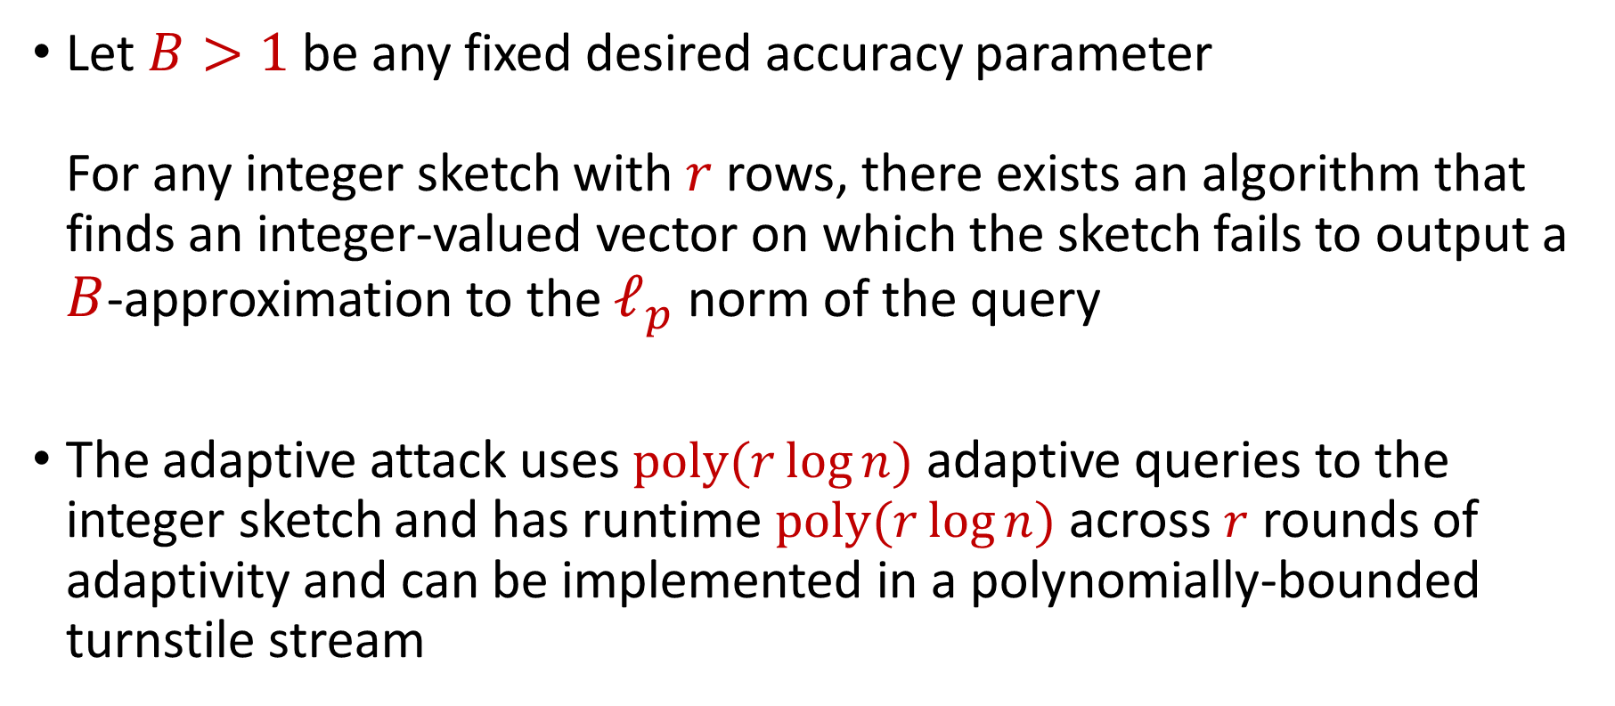
Our Results (Adversarial Robustness)
Let $B>1$ be any fixed desired accuracy parameter For any integer sketch with $r$ rows, there exists an algorithm that finds an integer-valued vector on which the sketch fails to output a $B$-approximation to the $ℓ_{p}$ norm of the query
The adaptive attack uses $poly(r\log{n})$ adaptive queries to the integer sketch and has runtime $poly(r\log{n})$ across $r$ rounds of adaptivity and can be implemented in a polynomially-bounded turnstile stream

Slide 42
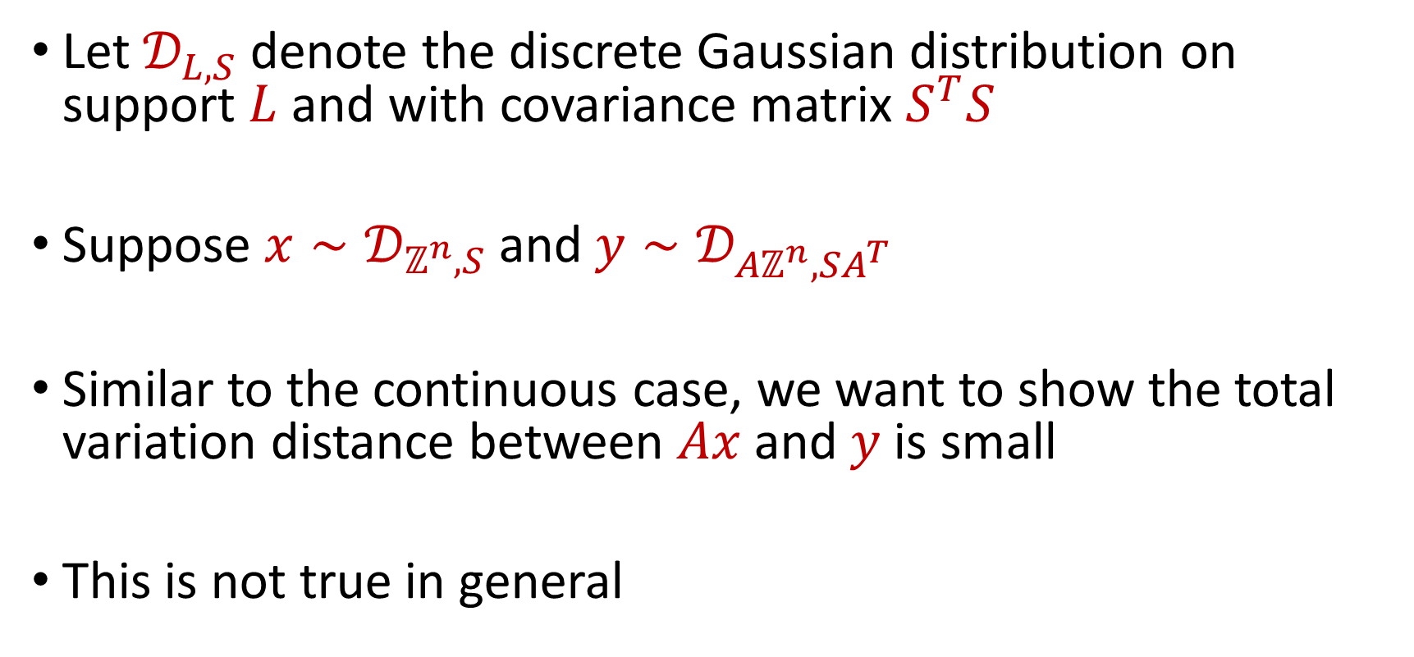
Technical Overview
Let $𝒟_{L, S}$ denote the discrete Gaussian distribution on support $L$ and with covariance matrix $S^{T}S$
Suppose ${x∼𝒟}_{ℤ^{n}, S}$and ${y∼𝒟}_{{Aℤ}^{n}, SA^{T}}$
Similar to the continuous case, we want to show the total variation distance between $Ax$and $y$is small
This is not true in general
Notes:
“lattice generated by A” or “lattice with basis A” or “image of the integer lattice under A”

Slide 43
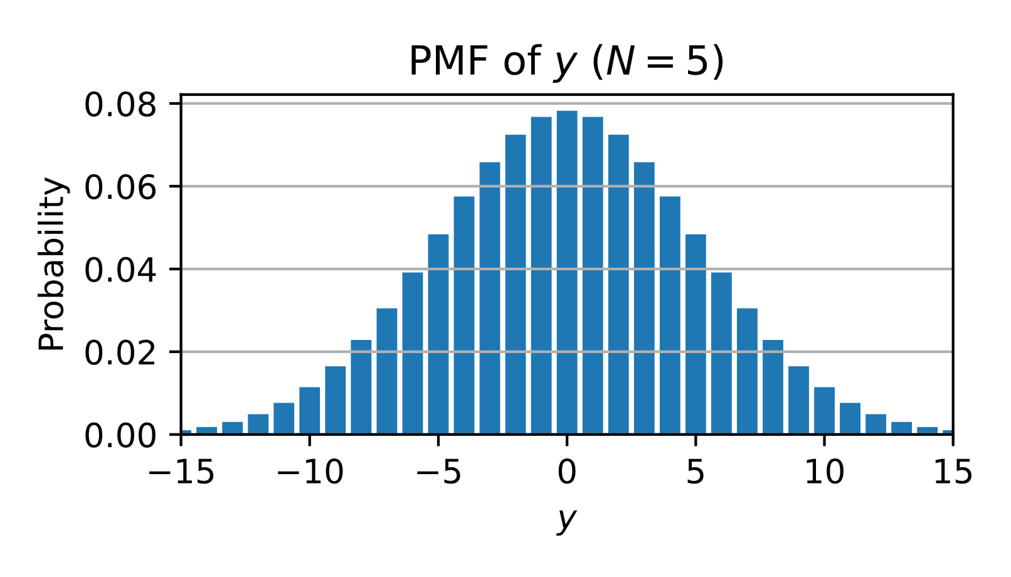
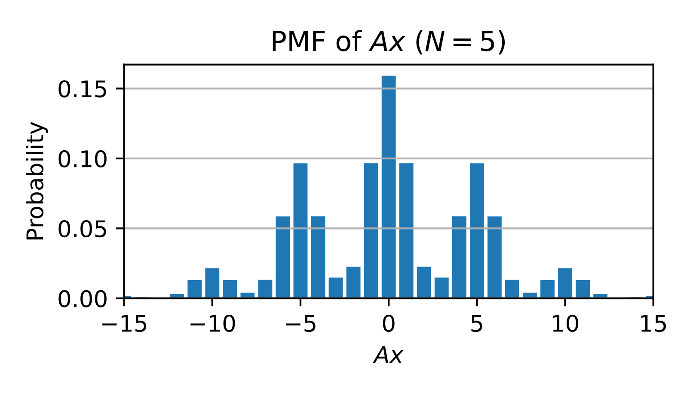
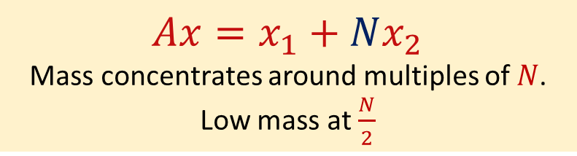
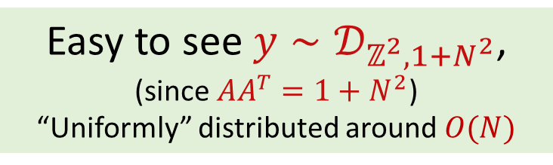
Example
Consider ${x∼𝒟}_{ℤ^{2}, { I}_{2}}$and ${y∼𝒟}_{{Aℤ}^{2}, A^{T}}$, where $A=[1 N]$
Easy to see ${y∼𝒟}_{ℤ^{2},1+N^{2}}$,
(since $AA^{T}=1+N^{2}$)
“Uniformly” distributed around $O(N)$
$Ax=x_{1}+Nx_{2}$
Mass concentrates around multiples of $N$.
Low mass at $\frac{N}{2}$

Slide 44
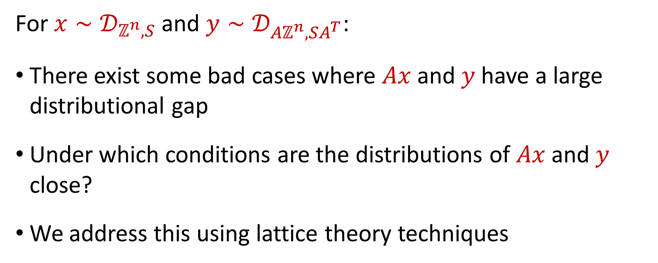
Lattice Theory Techniques
For ${x∼𝒟}_{ℤ^{n}, S}$and ${y∼𝒟}_{{Aℤ}^{n}, SA^{T}}$:
There exist some bad cases where $Ax$and $y$ have a large distributional gap
Under which conditions are the distributions of $Ax$and $y$ close?
We address this using lattice theory techniques

Slide 45
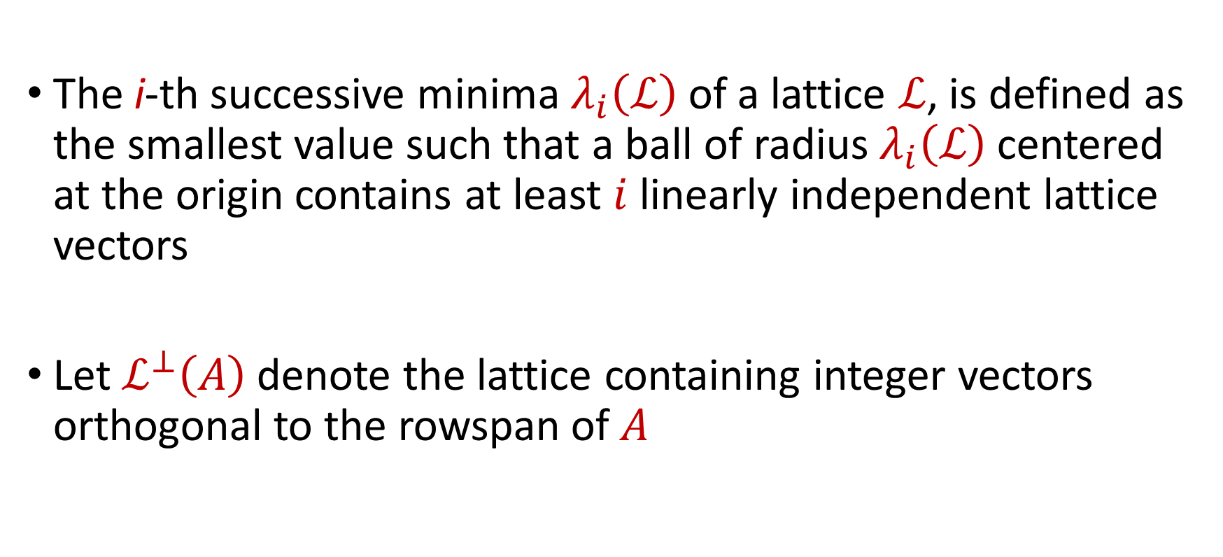
Lattice Theory Techniques
The i-th successive minima $λ_{i}\left(ℒ\right)$of a lattice $ℒ$, is defined as the smallest value such that a ball of radius $λ_{i}\left(ℒ\right)$centered at the origin contains at least $i$linearly independent lattice vectors
Let $ℒ^{⊥}\left(A\right)$denote the lattice containing integer vectors orthogonal to the rowspan of$A$

Slide 46
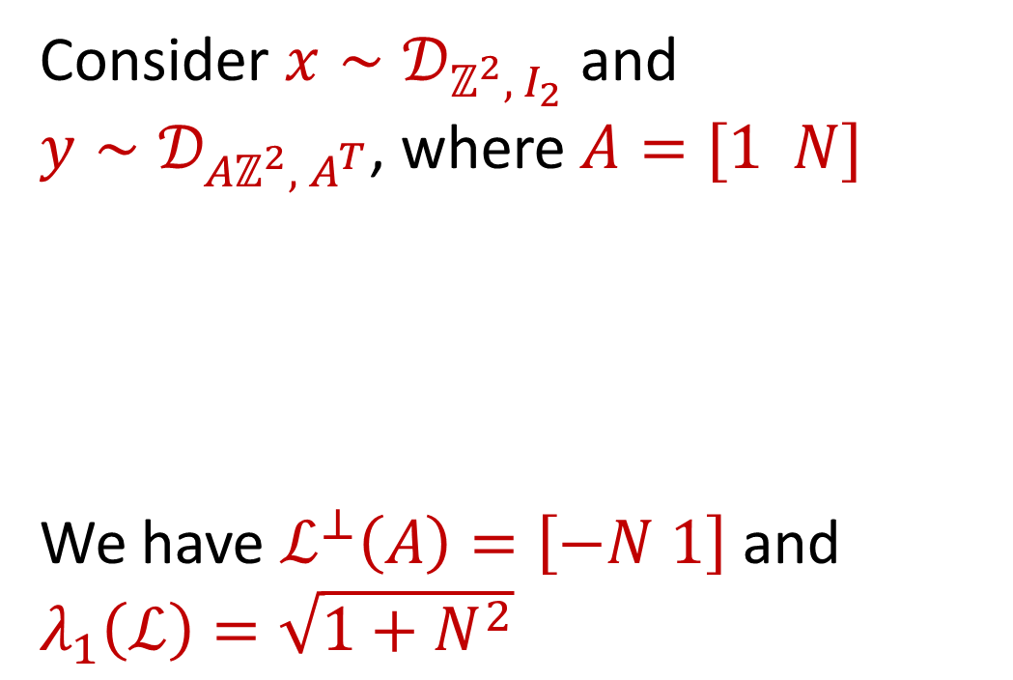
Example
Consider ${x∼𝒟}_{ℤ^{2}, { I}_{2}}$and ${y∼𝒟}_{{Aℤ}^{2}, A^{T}}$, where $A=[1 N]$
We have $ℒ^{⊥}\left(A\right)=\left[−N 1\right]$ and $λ_{1}\left(ℒ\right)=\sqrt{1+N^{2}}$

Slide 47
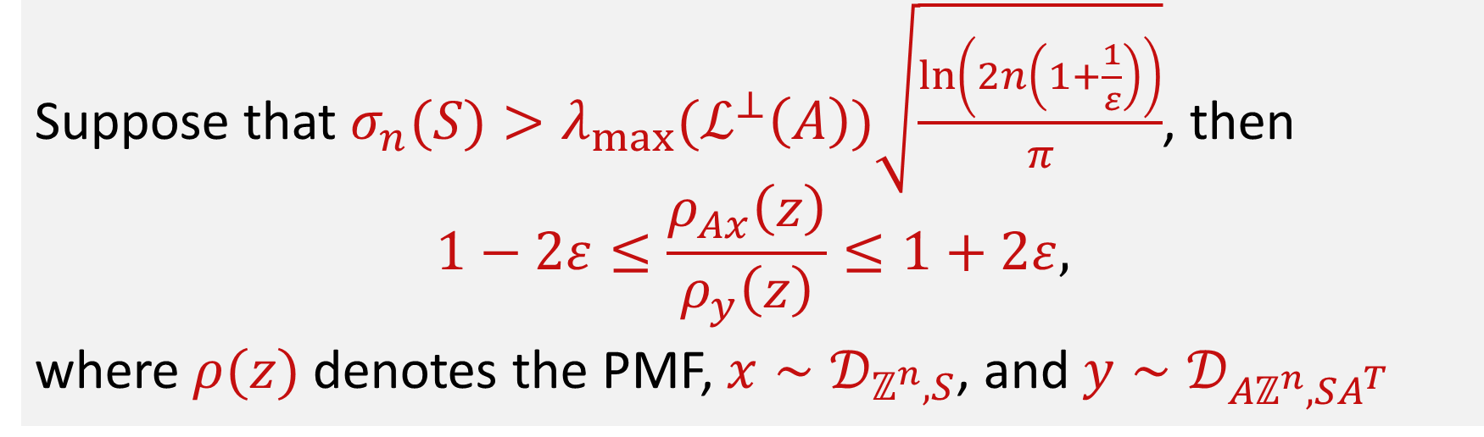
Lattice Theory Techniques
Thm. (Sufficient condition for small distributional gap [AR16])
Suppose that $σ_{n}(S)>{λ_{max}(ℒ}^{⊥}\left(A\right))\sqrt{\frac{\ln\left(2n\left(1+\frac{1}{ε}\right)\right)}{π}}$, then
$$1−2ε≤\frac{ρ_{Ax}\left(z\right)}{ρ_{y}\left(z\right)}≤1+2ε,$$
where $ρ(z)$ denotes the PMF, ${x∼𝒟}_{ℤ^{n}, S}$, and ${y∼𝒟}_{{Aℤ}^{n}, SA^{T}}$

Slide 48
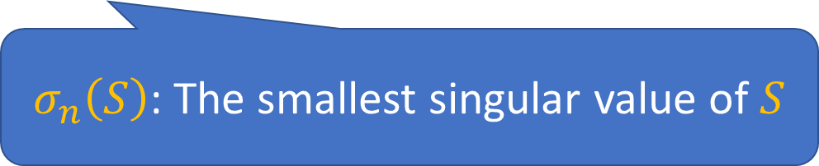
Lattice Theory Techniques
Thm. (Sufficient condition for small distributional gap [AR16])
Suppose that $σ_{n}(S)>{λ_{max}(ℒ}^{⊥}\left(A\right))\sqrt{\frac{\ln\left(2n\left(1+\frac{1}{ε}\right)\right)}{π}}$, then
$$1−2ε≤\frac{ρ_{Ax}\left(z\right)}{ρ_{y}\left(z\right)}≤1+2ε,$$
where $ρ(z)$ denotes the PMF, ${x∼𝒟}_{ℤ^{n}, S}$, and ${y∼𝒟}_{{Aℤ}^{n}, SA^{T}}$
$σ_{n}\left(S\right)$: The smallest singular value of $S$

Slide 49

Lattice Theory Techniques
Thm. (Sufficient condition for small distributional gap [AR16])
Suppose that $σ_{n}(S)>{λ_{max}(ℒ}^{⊥}\left(A\right))\sqrt{\frac{\ln\left(2n\left(1+\frac{1}{ε}\right)\right)}{π}}$, then
$$1−2ε≤\frac{ρ_{Ax}\left(z\right)}{ρ_{y}\left(z\right)}≤1+2ε,$$
where $ρ(z)$ denotes the PMF, ${x∼𝒟}_{ℤ^{n}, S}$, and ${y∼𝒟}_{{Aℤ}^{n}, SA^{T}}$
$ℒ^{⊥}\left(A\right)$: The lattice containing integer vectors orthogonal to the rowspan of$A$

Slide 50

Lattice Theory Techniques
Thm. (Sufficient condition for small distributional gap [AR16])
Suppose that $σ_{n}(S)>{λ_{max}(ℒ}^{⊥}\left(A\right))\sqrt{\frac{\ln\left(2n\left(1+\frac{1}{ε}\right)\right)}{π}}$, then
$$1−2ε≤\frac{ρ_{Ax}\left(z\right)}{ρ_{y}\left(z\right)}≤1+2ε,$$
where $ρ(z)$ denotes the PMF, ${x∼𝒟}_{ℤ^{n}, S}$, and ${y∼𝒟}_{{Aℤ}^{n}, SA^{T}}$
$λ_{max}$: The max successive minima of a lattice
The max successive minima $λ_{max}\left(ℒ\right)$of a lattice $ℒ$ is the smallest radius such that a ball centered at the origin contains a full basis for the lattice

Slide 51
Lattice Theory Techniques
Thm. (Sufficient condition for small distributional gap [AR16])
Suppose that $σ_{n}(S)>{λ_{max}(ℒ}^{⊥}\left(A\right))\sqrt{\frac{\ln\left(2n\left(1+\frac{1}{ε}\right)\right)}{π}}$, then
$$1−2ε≤\frac{ρ_{Ax}\left(z\right)}{ρ_{y}\left(z\right)}≤1+2ε,$$
where $ρ(z)$ denotes the PMF, ${x∼𝒟}_{ℤ^{n}, S}$, and ${y∼𝒟}_{{Aℤ}^{n}, SA^{T}}$
If $ε=\frac{1}{poly\left(n\right)}$, the sketch matrix $A$ “passes” through to the covariance

Slide 52

Bounding the Successive Minima
[AR16] requires $σ_{n}(S)> {λ_{max}(ℒ}^{⊥}\left(A\right))⋅\sqrt{\frac{\ln\left(2n\left(1+\frac{1}{ε}\right)\right)}{π}}$
We can scale $S$ so that $σ_{n}\left(S\right)>poly\left(n\right)$
Hence, we want to upper bound ${λ_{max}(ℒ}^{⊥}\left(A\right))$ by $poly(n)$
However, this is not true in general

Slide 53

A Simple Example
$$A=\left[\begin{matrix}\begin{matrix}1 & −2 & 0 \\ 0 & 1 & −2 \\ 0 & 0 & 1\end{matrix} & ⋯ & ⋯ \\ ⋮ & ⋱ & ⋮ \\ ⋯ & ⋯ & \begin{matrix}−2 & 0 \\ 1 & −2\end{matrix}\end{matrix}\right]$$
$\left[2^{n}, 2^{n−1},…,2,1\right]∈A^{⊥}$ has exponentially large entries!

Slide 54

Bounding the Successive Minima
[AR16] requires $σ_{n}(S)> {λ_{max}(ℒ}^{⊥}\left(A\right))⋅\sqrt{\frac{\ln\left(2n\left(1+\frac{1}{ε}\right)\right)}{π}}$ and we can design $S$ so that $σ_{n}\left(S\right)>poly\left(n\right)$
Key observation: we can add more rows to $A$, as it only makes the sketching matrix stronger
What to do next: pre-process $A$ to matrix $A′$ with $r^{′}=O(r)$ rows such that ${λ_{max}(ℒ}^{⊥}\left(A′\right))$ $≤poly(n)$

Slide 55

Bounding the Successive Minima
[Siegel’s Lemma]. Let $A∈ℤ^{r×n}$ be a nonzero integer matrix with $r<n$and entries bounded by $M$. Then there exists a nonzero vector $x$of integers bounded by ${\left(nM\right)}^{r/(n−r)}$such that $Ax=0^{r}$
First idea: iteratively add rows to $A$ using Siegel’s Lemma.
What next to do: pre-process $A$ to matrix $A′$ with $r^{′}≥ r$ rows such that ${λ_{n −r′}(ℒ}^{⊥}\left(A′\right))$ $≤poly(n)$

Slide 56

Bounding the Successive Minima
Goal: pre-process $A$ to matrix $A′$ with $r^{′}≥ r$ rows such that ${λ_{n −r′}(ℒ}^{⊥}\left(A′\right))$ $≤poly(n)$
Let $A_{0}=A$, and in each time step $t$, find a vector $x_{t}$ such that $A_{t}x_{t}=0$ and add $x_{t}$ to form matrix $A_{t+1}$
Repeat $0.49n−r$ times. From Siegel’s Lemma we have the entries of $x_{t}$ is bounded by $nM$
Continue to apply Siegel’s Lemma to generate the next $0.51n$ vectors $y_{1},y_{2},…, y_{0.51n}$ (whose entries are un-bounded)
Add rows $y_{1},y_{2},…, y_{0.51n}$ to $A$, form the matrix $A′$

Slide 57

Bounding the Successive Minima
First idea: iteratively add rows to $A$ using Siegel’s Lemma
What next to do: pre-process $A$ to matrix $A′$ with $r^{′}≥ r$ rows such that ${λ_{n −r′}(ℒ}^{⊥}\left(A′\right))$ $≤poly(n)$
Then $A′$ satisfies the condition for [AR16] for TVD closeness
However, $A′$ has $cn+r$ rows, which can not obtain optimal lower bound for some cases
A better analysis is needed

Slide 58


Preprocessing
Goal: pre-process $A$ to matrix $A′$ with $r^{′}=O(r)$ rows such that ${λ_{max}(ℒ}^{⊥}\left(A′\right))$ $≤poly(n)$
Full basis of an $n$-dim space

Slide 59


Preprocessing
Goal: pre-process $A$ to matrix $A′$ with $r^{′}=O(r)$ rows such that ${λ_{max}(ℒ}^{⊥}\left(A′\right))$ $≤poly(n)$
Row space of $A$ ($r$ dimensions)
Row space of $ℒ^{⊥}\left(A\right)$ ($n−r$ dimensions)

Slide 60


Preprocessing
Goal: pre-process $A$ to matrix $A′$ with $r^{′}=O(r)$ rows such that ${λ_{max}(ℒ}^{⊥}\left(A′\right))$ $≤poly(n)$
Row space of $A$ ($r$ dimensions)
Construct via a probabilistic argument:
$n−4r$ linearly independent integer vectors in $ℒ^{⊥}\left(A\right)$ with entries bounded by $poly(n)$

Slide 61

Preprocessing
Goal: pre-process $A$ to matrix $A′$ with $r^{′}=O(r)$ rows such that ${λ_{max}(ℒ}^{⊥}\left(A′\right))$ $≤poly(n)$
Row space of $A$ ($r$ dimensions)
Construct iteratively:
The remaining $3r$ integer vectors
Construct via a probabilistic argument:
$n−4r$ linearly independent integer vectors in $ℒ^{⊥}\left(A\right)$ with entries bounded by $poly(n)$

Slide 62



Preprocessing
Goal: pre-process $A$ to matrix $A′$ with $r^{′}=O(r)$ rows such that ${λ_{max}(ℒ}^{⊥}\left(A′\right))$ $≤poly(n)$
$$A′$$
Row space of $A′$ ($4r$ dimensions)
Construct via a probabilistic argument:
$n−4r$ linearly independent integer vectors in $ℒ^{⊥}\left(A\right)$ with entries bounded by $poly(n)$
$$𝓛^{⊥}(A^{′})$$

Slide 63

Preprocessing
Goal: pre-process $A$ to matrix $A′$ with $r^{′}=O(r)$ rows such that ${λ_{max}(ℒ}^{⊥}\left(A′\right))$ $≤poly(n)$
$$A′$$
Row space of $A′$ ($4r$ dimensions)
By definition of successive minima:
${λ_{max}(ℒ}^{⊥}\left(A′\right))$ $≤poly(n)$
Construct via a probabilistic argument:
$n−4r$ linearly independent integer vectors in $ℒ^{⊥}\left(A\right)$ with entries bounded by $poly(n)$
$$𝓛^{⊥}(A^{′})$$

Slide 64

Preprocessing
We show that we can generate $n−O(r)$ linearly independent integer vectors in $ℒ^{⊥}\left(A\right)$ with entries bounded by $poly(n)$
Probabilistic argument: Suppose we have found $t$ such vectors
Let $B∈ℝ^{\left(n−t\right) × n}$ denote the matrix whose rows form a basis of the orthogonal complement to the span of these $t$vectors

Slide 65

Probabilistic Argument for Preprocessing
Randomly pick $s= n^{O(r)}$ vectors $v^{i}$ with entries in $\left\{0, 1, 2,…, M−1\right\}$, for sufficiently large $M=poly(n)$
Event (i): There exists $1≤i<j≤s$ such that ${Av}^{i}=Av^{j}$
Event (i) holds with high probability: the entries of ${Av}^{i}$ are bounded by $poly(n)$, so use birthday paradox

Slide 66

Probabilistic Argument for Preprocessing
Randomly pick $s= n^{O(r)}$ vectors $v^{i}$ with entries in $\left\{0, 1, 2,…, M−1\right\}$, for sufficiently large $M=poly(n)$
Event (ii): For all $1≤i<j≤s$ we have ${Bv}^{i}≠Bv^{j}$
Event (ii) holds with high probability: W.L.O.G., we can write B in reduced row echelon form
Then for every $v^{i},v^{j}$ we have $Pr\left[B\left(v^{i}−v^{j}\right)=0\right]≤{\left(\frac{1}{M }\right)}^{n − t}$
Take a union bound over all$i, j$

Slide 67

Bounding the Successive Minima
Randomly pick $s= n^{O(r)}$ vectors $v^{i}$ with entries in $\left\{0, 1, 2,…, M−1\right\}$, for sufficiently large $M=poly(n)$
Conditioning on events (i) and (ii) holding, then $v^{i}−v^{j}$ is the vector we need
It is in kernel of $A$ so in orthogonal lattice
It is not in kernel of rows in orthogonal lattice already found
We can iteratively apply this argument until $t=n−O(r)$

Slide 68

Bounding the Successive Minima
Suppose we have chosen these $n −O(r)$vectors
Iteratively generate $O(r)$ integer vectors that are orthogonal to both the row span $A$of and the $n−4r$ integer vectors
Add these $O(r)$ vectors to rows of $A$ and form a new matrix $A′$ with $O(r)$ rows, which satisfies the requirement

Slide 69
Questions?
Upcoming
Cell lemma and lifting framework

Slide 70




Cell Lemma
Recall $x∼$ $𝒟_{ℤ^{n}, S}$, $y {∼𝒟}_{{Aℤ}^{n}, SA^{T}}$, and $z∼N(0, S^{T}S)$
Can assume $ℒ^{⊥}\left(A\right)$ has bounded successive minima
Let $η$ be a uniform noise in one unit cell of the lattice $Aℤ^{n}$
Goal:
Distribution of $Ax+η$
Close to
Distribution of $Az$
≈ Discrete sketch
Continuous sketch

Slide 71







Cell Lemma
Recall $x∼$ $𝒟_{ℤ^{n}, S}$, $y {∼𝒟}_{{Aℤ}^{n}, SA^{T}}$, and $z∼N(0, S^{T}S)$
Can assume $ℒ^{⊥}\left(A\right)$ has bounded successive minima
Let $η$ be a uniform noise in one unit cell of the lattice $Aℤ^{n}$
Distribution of $Ax+η$
Distribution of $Az$
[AR16]
$$≈_{1+1/poly(n)}$$
Distribution of $y+η$
$$≈_{1+1/poly(n)}$$
$N(0, A^{T}S^{T}SA)$.

Slide 72



Cell Lemma
Distribution of $Ax+η$
Close to
Distribution of $Az$
≈ Discrete sketch
Continuous sketch
Real discrete sketches take $Ax$ as inputs. Why is the above useful?

Slide 73

Cell Lemma
Distribution of $Ax+η$
Close to
Distribution of $Az$
≈ Discrete sketch
Continuous sketch
Real discrete sketches take $Ax$ as inputs. Why is the above useful?
$Ax$ can be recovered from $Ax+η$ by rounding
The rounding operation can be baked into post-processing:
$$g\left(Ax\right)=g∘round\left(Ax+η\right)$$

Slide 74

Cell Lemma
Distribution of $Ax+η$
Close to
Distribution of $Az$
≈ Discrete sketch
Continuous sketch
Real discrete sketches take $Ax$ as inputs. Why is the above useful?
$Ax$ can be recovered from $Ax+η$ by rounding
The rounding operation can be baked into post-processing:
$$g\left(Ax\right)=g∘round\left(Ax+η\right)$$
Thus, we can assume the (discrete) algorithm takes $Ax+η$ as inputs
So it should also work for $Az$ (continuous input)

Slide 75
Our Results (Applications)
We apply our lifting technique to obtain optimal lower bounds:

Slide 76


Application: $ℓ_{p}$ Norm Estimation, $p∈[1,2]$
$f\left(x\right)=\left\{\begin{aligned}0, {\left\|x\right\|}_{2}≤\left(1+ε\right)N \\ 1, {\left\|x\right\|}_{2}≥\left(1+3ε\right)N \\ ⊥, otherwise \end{aligned}\right.$
$Y_{1 }∼N(0, {N^{2}I}_{n})$ vs. $Y_{2 }∼N(0, {{{\left(1+4ε\right)}^{2}N}^{2}I}_{n})$
With high probability, $\underset{x∼Y_{1}}{Pr}\left[f\left(x\right)=1\right]$ and $\underset{y∼Y_{2}}{Pr}\left[f\left(y\right)=0\right]$
Notes:
N is a large polynomial in n, bounds due to tail bounds on chi squared distribution

Slide 77

Application: $ℓ_{p}$ Norm Estimation, $p∈[1,2]$
With high probability, $\underset{x∼Y_{1}}{Pr}\left[f\left(x\right)=1\right]$ and $\underset{y∼Y_{2}}{Pr}\left[f\left(y\right)=0\right]$
However, $d_{TV}\left(Ax,Ay\right)≤1−δ$ unless $A$ has sketching dimension $Ω\left(\frac{1}{ε^{2}}\log{\frac{1}{δ}}\right)$
Our technique recovers the same bound for integer sketches

Slide 78


Application: $ℓ_{p}$ Norm Estimation, $p>2$
$𝒟_{1}=N(0, {N^{2}I}_{n})$
$𝒟_{2}=N\left(0, {N^{2}I}_{n}\right)+\sum_{i∈[T]}{Θ\left(\frac{ε^{1/p}Nn^{1/p}}{t^{1/p}}\right)}e_{i}$, where $T$ is a random set of $O\left(\log{\frac{1}{δ}}\right)$ coordinates of $[n]$
With high probability, $\underset{x∼𝒟_{1}}{Pr}\left[{\left\|x\right\|}_{p}≤\left(1+2ε\right)Nβ\right]$ and$\underset{y∼𝒟_{2}}{Pr}\left[{\left\|y\right\|}_{p}≥\left(1+4ε\right)Nβ\right]$

Slide 79

Application: $ℓ_{p}$ Norm Estimation, $p>2$
With high probability, $\underset{x∼𝒟_{1}}{Pr}\left[{\left\|x\right\|}_{p}≤\left(1+2ε\right)Nβ\right]$ and$\underset{y∼𝒟_{2}}{Pr}\left[{\left\|y\right\|}_{p}≥\left(1+4ε\right)Nβ\right]$
However, $d_{TV}\left(Ax,Ay\right)≤1−δ$ unless $A$ has sketching dimension $Ω\left(n^{1−2/p}\frac{1}{ε^{−2/p}}\log{n}\log^{2/p}{\frac{1}{δ}}\right)$
Our technique recovers the same bound for integer sketches

Slide 80

Reconstruction Attack on Linear Sketches
Linear sketches for $ℓ_{p}$ estimation ($p$ > $0$) are “not robust” to adversarial attacks, require $Ω(n)$ dimension [HW13]
Approximately learn sketch matrix $A$, query something in the kernel of $A$
Iterative process, start with $V_{1}=∅,…,V_{r}$
Correlation finding: Find vectors weakly correlated with $A$ orthogonal to $V_{i−1}$
Boosting: Use these vectors to find strongly correlated vector $v$
Progress: Set $V_{i}=span(V_{i−1},v)$

Slide 81

Correlation Finding
Start with a subspace $V_{i}$, iterate over small increments of $σ^{2}$
Sample $v_{1},…,v_{m}∼𝒟_{ℤ^{n}, Σ_{σ^{2}}}$, where $Σ_{σ^{2}}$ is a covariance matrix that projects onto $V_{i}^{⊥}$ and scaled by $σ^{2}$, up to some small noise ($m=poly(n)$)
Let ${v′}_{1},…,{v′}_{m^{′}}$ be the positively labeled samples, i.e., $𝔸\left({v^{′}}_{i}\right)=1$

Slide 82

Boosting and Progress
Let $v_{σ}={argmax}_{u} ∑{\left\langle u,v_{i}^{′}\right\rangle }^{2}$
If $\frac{1}{m^{′}}⋅∑{\left\langle v_{σ},v_{i}^{′}\right\rangle }^{2}≥σ^{2}+Δ$ for some gap $Δ$, add $v^{∗}$ to $V_{i}$, where $v^{∗}$ is the part of $v_{σ}$ orthogonal to $V_{i}$

Slide 83


Slide 84

Conditional Expectation Lemma
There exists a variance $σ^{2}$ and a vector $u∈A∩V_{i}^{⊥}$such that for $x∼𝒟_{ℤ^{n}, Σ_{σ^{2}}}$,
Proof by lifting to continuous version of conditional expectation lemma [HW13]
$$𝔼\left[{\left\langle u,x\right\rangle }^{2}|𝔸\left(x\right)=1\right]≥𝔼\left[{\left\langle u,x\right\rangle }^{2}\right]+Δ$$

Slide 85
Summary
We give a framework for “lifting” lower bound techniques for linear sketches to integer sketches
Idea is to use discrete Gaussians in place of a continuous Gaussian on “well-behaved” sketches
Can be used to achieve lower bounds for a range of problems, including adversarial robust norm estimation

Slide 86








$$≈_{1+1/poly(n)}$$
(in TVD), by [AR16]
Integer sketch sees:
$Ax$, ${x∼𝒟}_{ℤ^{n}, S}$
$${y∼𝒟}_{{Aℤ}^{n}, SA^{T}}$$
add uniform noise $η$ in unit cell of the lattice $A{⋅ℤ}^{n}$.
implies
continuous algorithm reduction
$$≈_{1+1/poly(n)}$$
$Ax+η$
$y+η$
$$≈_{1+1/poly(n)}$$
Conclusion!
$$≈_{1+1/poly(n)}$$
$$q∼N(0, AS^{T}SA^{T})$$
(numerical closeness of PDF and PMF functions)
Cell Lemma

Slide 87





Future Directions
Lower bounds for streaming beyond integer linear sketches?
Attacks on linear-sketches for $ℓ_{0}$ estimation [GLWYZ24]
Attacks on streaming algorithms for $ℓ_{0}$ estimation
Attacks on linear-sketches for $ℓ_{p}$ estimation [This talk]
Attacks on streaming algorithms for $ℓ_{p}$ estimation

